Slide 1
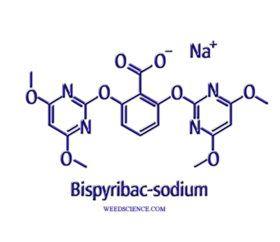
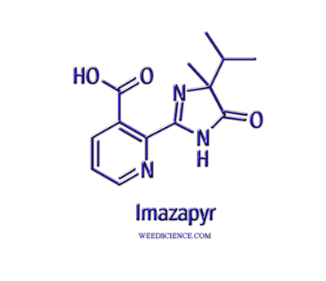
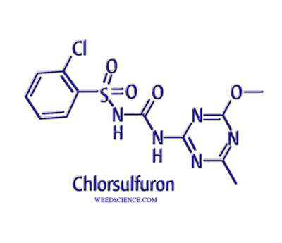
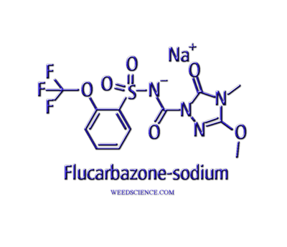
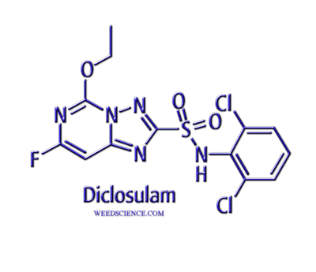
Acetolactate Synthase Inhibitors

Slide 2
Acetolactate Synthase Inhibitors
IMI = Imidazolinones (6)
Imazapyr, imazaquin, imazethapyr, imazapic, imazamox
PTB = Pyrimidinylthiobenzoates (5)
bispyribac-sodium, pyrithiobac-sodium
SCT = Sulfonylaminocarbonyltriazolinone (2)
flucarbazone-sodium, propoxycarbazone-sodium
SU = Sulfonylureas (32)
Chlorsulfuron, halosulfuron, metsulfuron, nicosulfuron……
TP = Triazolopyrimidines (7)
Flumetsulam, diclosulam, penoxsulam….

Slide 3
ALS History
Sulfonylureas discovered in late 1970’s, first commercialized in 1982 by DuPont
Imidazolinones discovered in late 1970’s, commercialized in 1984, widespread use in 1986 by American Cyanamid (BASF)
Other chemistries followed in 1990’s, primarily DowAgro Sciences

Slide 4
Acetolactate Synthase Inhibitors
Extraordinary chemistry at the time of discovery
Incredibly low use rates (grams per hectare/oz per acre)
Very selective
Residual control
Low toxicity
Weak acid chemistry, highly mobile within plants
Changed weed control and management, but also affected herbicide registration for many years

Slide 5
Imidazolinones
Used on a variety of crops and vegetation management situations
Soybeans (imazaquin, imazethapyr, imazamox)
Peanuts (imazethapyr, imazapic)
Turf (imazaquin, imazapic)
Some veggies (imazethapyr)
Forestry (imazapyr)
Natural areas (imazapyr, imazapic, imazamox)
Pastures, rangeland
Broadleaves, grasses, sedges…….. but also shrubs, brush, cattails, trees

Slide 6
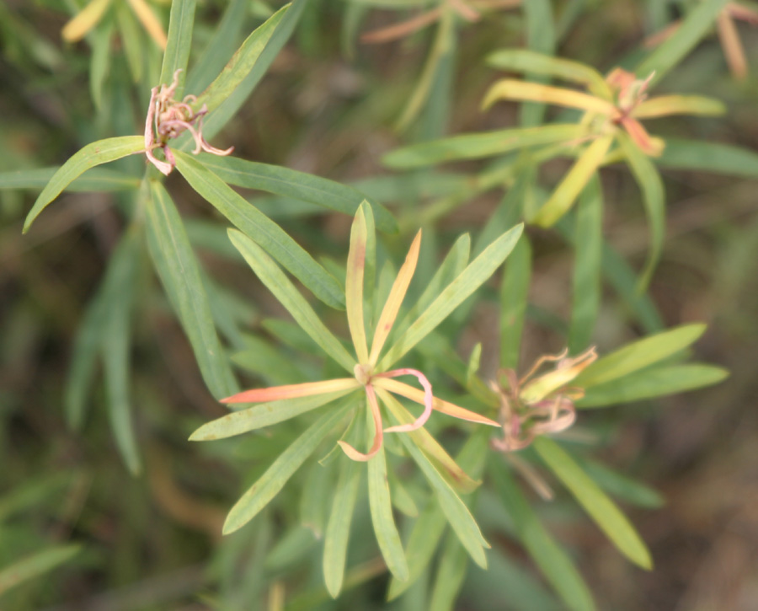
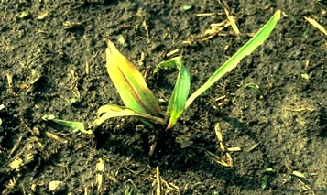
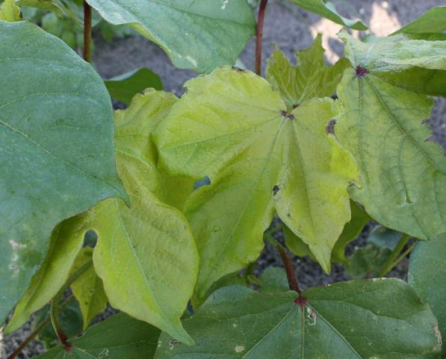
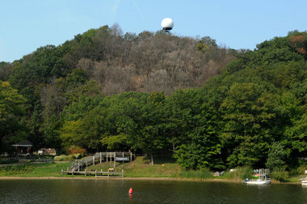

Slide 7
Sulfonlyureas
Used on a variety of crops and vegetation management situations
Soybeans, corn, sugarcane, rice, turf, canola, veggies, natural areas, forestry, aquatics, peanuts, cotton………………………………..
Broadleaves, grasses, sedges…….. but also shrubs, brush, rangeland

Slide 8
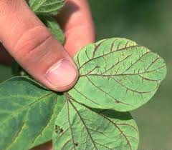
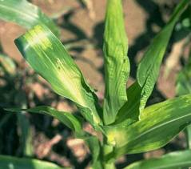
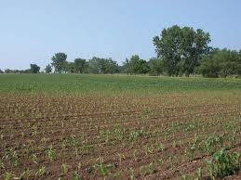
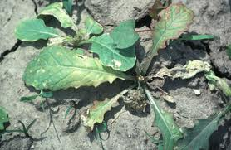

Slide 9
Mode of Action
Soil uptake from preplant incorporated or preemergence applications
Foliar uptake from postemergence applications
Extensively translocated to growing regions, apical meristems
Injury symptoms within 7-10 days, slow plant death – may take up to 4 weeks

Slide 10
Mechanism of Action
Inhibit the enzyme acetolactate synthase (ALS) or acetohydroxy acid synthase (AHAS)
Catalyzes double reaction
2 ketobutyrate to 2 acetohydroxybutyrate
Pyruvate to 2-acetolactate
Key enzyme in the formation of branched chain amino acids
Leucine, isoleucine, and valine

Slide 12
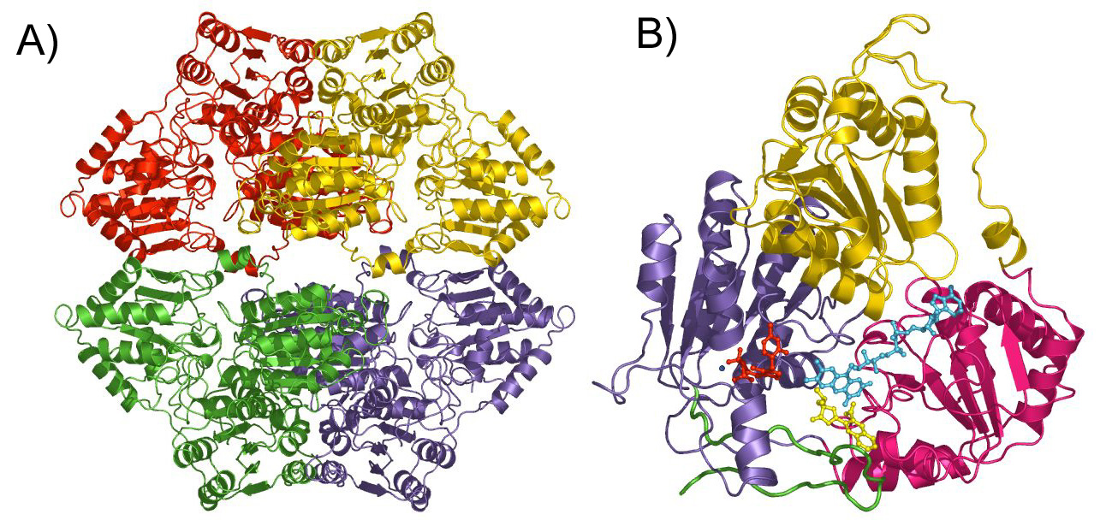
For many years, the exact mechanism of activity was unknown.

Slide 13
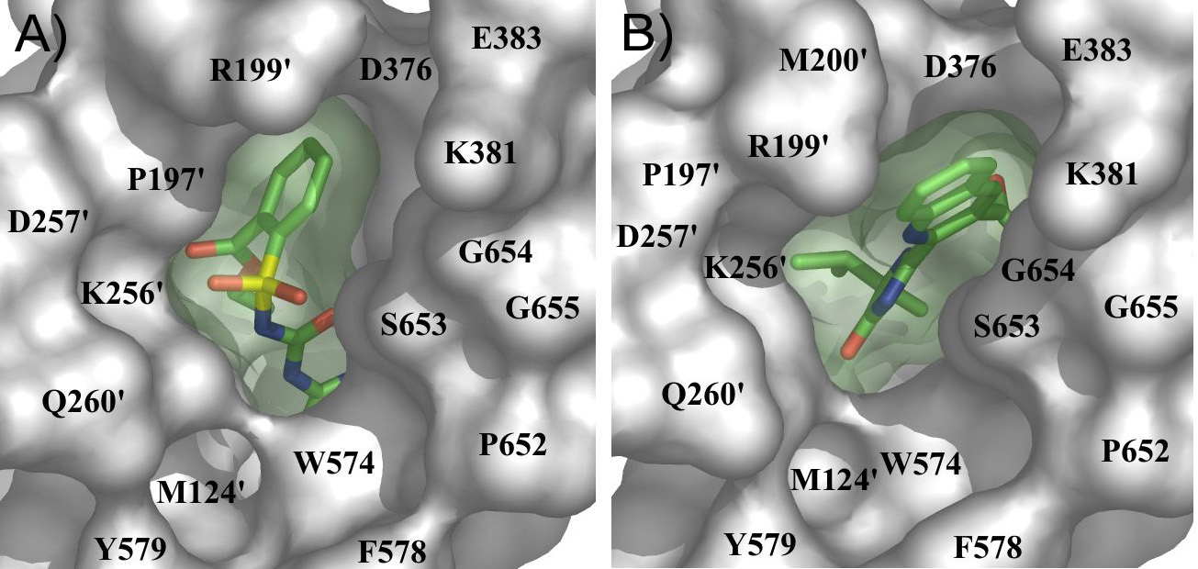
chlorimuron
imazaquin
*McMourt, J.A., S.S. Pang, J. King-Scott, L.W. Guddat and R.G. Duggleby. 2006. Herbicide-binding sites revealed in the structure of plant acetohydroxyacid synthase. PNAS 103:569-573.

Slide 14
Mechanisms of Tolerance/Selectivity
Primarily based on metabolism, not target site differences
Mixed function oxidases – cytochrome P450
Essentially incorporate molecular oxygen O2 into the substrate and also product a molecule of water
Can be inhibited by certain organophosphate (OP) insecticides

Slide 15
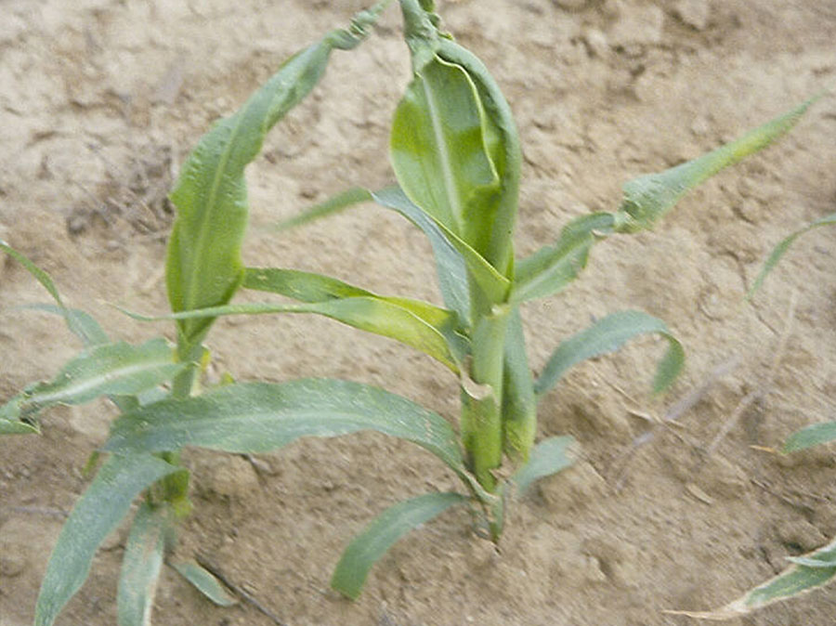
Nicosulfuron (Accent)
Used for johnsongrass control in corn
Damage to corn from in-furrow OP insecticides
Farmers not happy
??????????
Who is too blame?
Major label changes

Slide 16
IMI, STS and Clearfield
Somoclonal variability and also chemical mutagensis to produce crops and varieties tolerant to these chemistries
Selection for amino acid substitution in the target enzyme
Corn (IMI-corn by Pioneer – unsuccessful)
STS soybeans (DuPont – unsuccessful)
Clearfield - rice, sunflowers, wheat, canola

Slide 17
Resistance is Rampant
http://www.weedscience.com/Mutations/MutationDisplayAll.aspx

