Slide 1
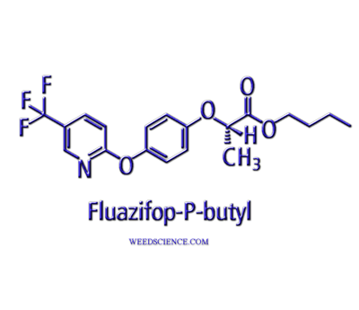
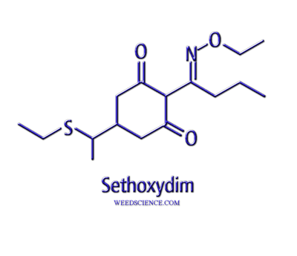
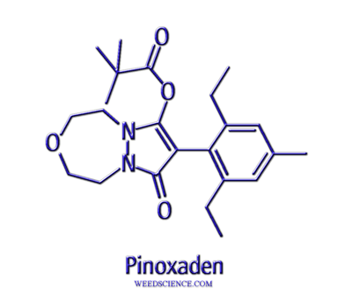
Acetyl CoA Carboxylase Inhibiting Herbicides

Slide 2
ACCase Inhibitors
Aryloxyphenoxypropionates (FOPs)
cyhalofop, diclofop, fenoxaprop, fluazifop, haloxyfop, propaquizafop, quizalofop,
Cyclohexanediones (DIMs)
Alloxydim, butroxydim, clethodim, cycloxydim, profoxydim, sethoxydim, tepraloxydim, tralkoxydim
Phenylpyrazoline
pinoxaden

Slide 3
Postemergence Control of Poaceae ‘Post Grass Herbicides’
Both fops and dims discovered and tested in the early 1980’s
Afforded the ability to remove grasses from all other plant families
Wide-spread registrations in several non-grass crops by the 1990’s
Primarily postemergence at labeled rates, although diclofop is labeled for use PRE

Slide 4
HOWEVER…………………..
Really need is grass control in grasses
Diclofop used for ryegrass, cheat in wheat
Cyhalofop grass control in rice
Clethodim for grass control in centipedegrass
Pinoxedim grass control in cereals

Slide 5
Mode of Action
Readily absorbed by foliage and roots (if available)
Mobile in phloem (weak acid)
Can be translocated via xylem
Accumulates in apical meristems

Slide 6
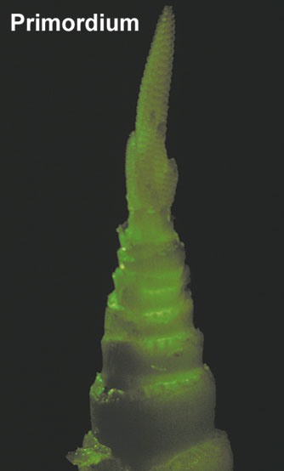
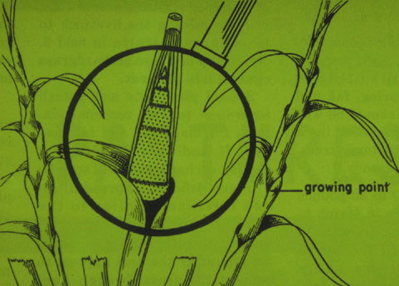
The Grass Meristem

Slide 7
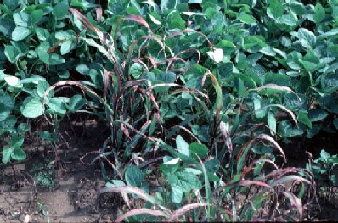
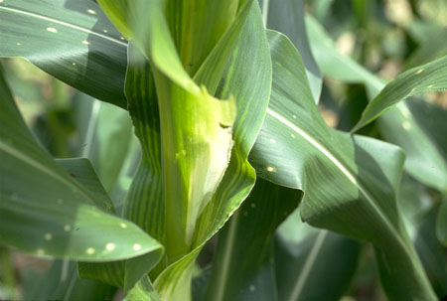
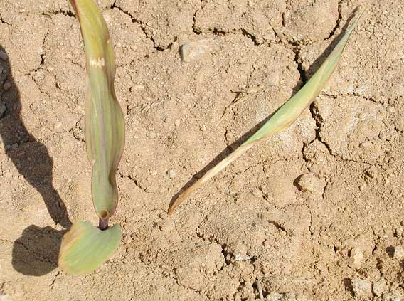
Acetyl CoA Carboxylase

Slide 8
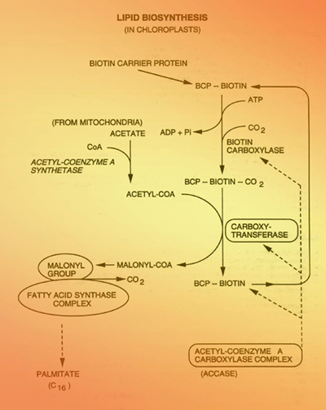
Mechanism of Action

Slide 9
Mechanism of Action
Two types of ACCase produced in plants
Heteromeric multisubunit form in plastid
Homodimeric form in cytosol
Poaceae is different
Homodimeric forms in both plastids and cytosol
Heteromeric forms missing
Herbicides inhibit the plastid homodimeric form

Slide 10
Selectivity Mechanisms
Insensitive forms of the enzyme in other plants besides grasses
Selectivity mechanisms in grass crops - Primarily metabolism
Fenoxyprop used in wheat with 2,4-D, antagonizes activity
Recent insertion of aryloxyalkanoate dioxygenase transgenes

Slide 11
Weed Resistance
Mutations in target site (single amino acid substitution)
isoleucine to leucine confers tolerance to sethoxydim and haloxyfop for wheat
Lolium spp.
Enhanced metabolism, primarily mixed function oxidases (cytochrome P450)

Slide 12
Sethoxydim corn (SR corn)
Natural selection in midwest corn and soybean cropping systems
Sethoxydim used to control volunteer corn
Observed tolerance/resistance in field
Selections, traditional breeding techniques to incorporate resistance into varieties
Altered enzyme - mutation

Slide 13
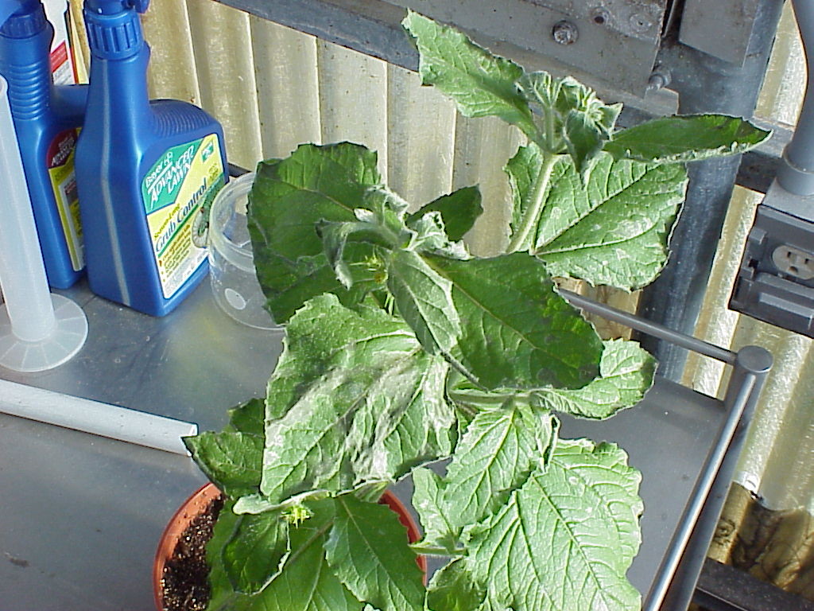
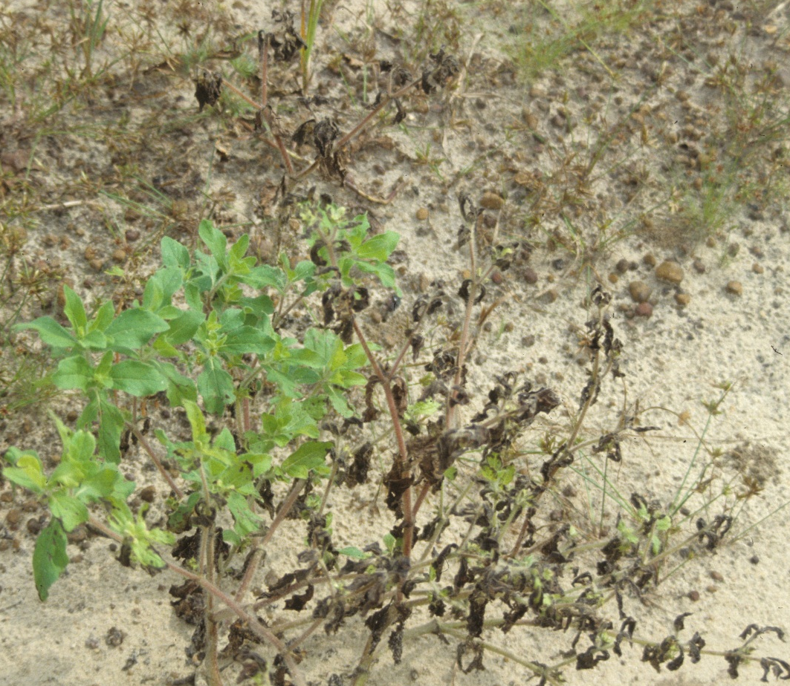
Bristly starbur – fluazifop??

Slide 14
Bristly starbur – fluazifop??
Contact activity – limited translocation
Rapid watersoaking and necrosis
Not associated with other post-grass herbicides
Not associated with formulation or inerts
Different mechanism of action

