Slide 1

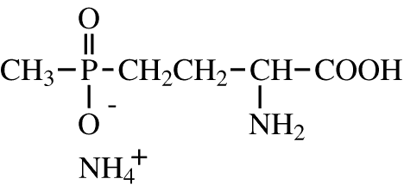
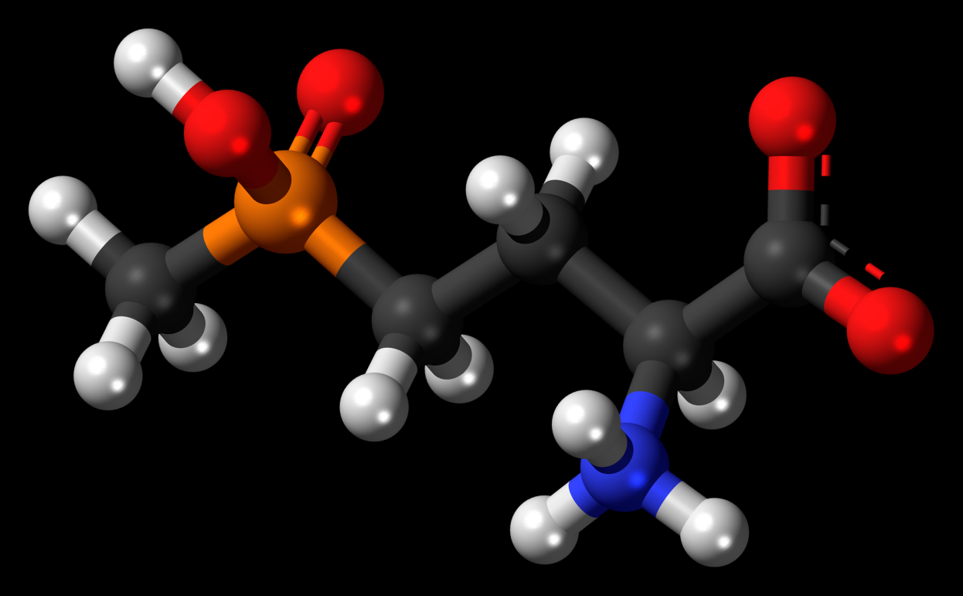
Glufosinate

Slide 2
Glufosinate
Also known as phosphinothricin (Bayer)
Introduced in Europe - late 1980’s, early 1990’s (Basta)
Introduced into U.S. in 1994 as Finale
Later registrations included Ignite, Rely, Liberty
Liberty is the most common name for use in transgenic agronomic crops - LibertyLink

Slide 3
Glufosinate
Foliar uptake and mostly contact in activity
Limited uptake by roots, due to rapid breakdown
Non-selective but more effective on broadleaves
Limited translocation, dependent on species

Slide 4
Glufosinate
soil/environmental behavior
– weakly bound to soil and highly mobile
– rapidly degraded by soil microbes, precluding problems with leaching

Slide 5
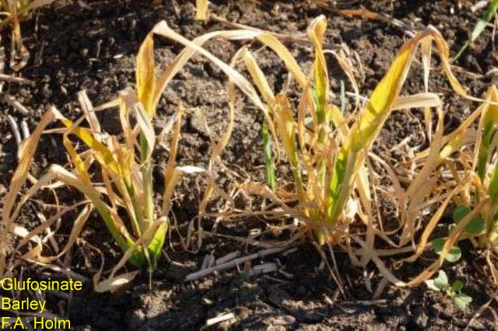
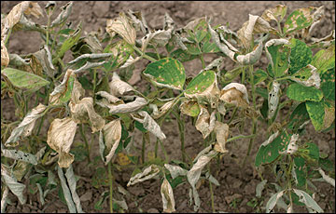
Glufosinate
injury symptoms appear 3 to 5 days after treatment
symptoms begin with chlorosis and wilting, followed by necrosis and death

Slide 6
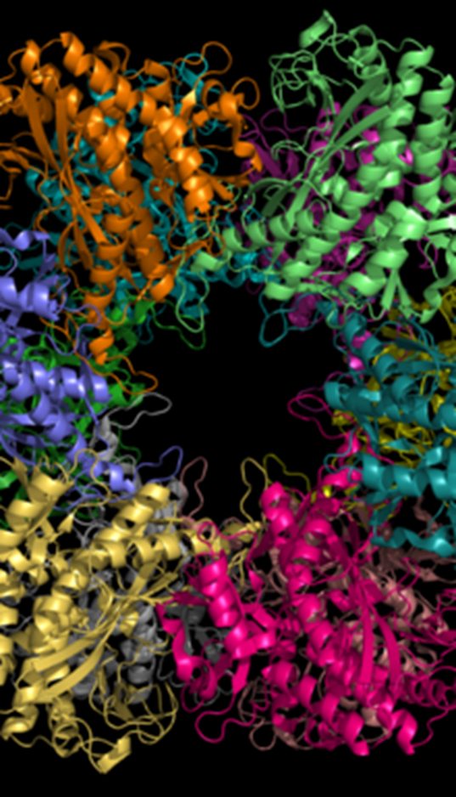
Glufosinate
Inhibits the activity glutamine synthetase
responsible for the conversion of ammonia into amino acids
Results in a build up toxic levels of ammonia, leading to cellular disruption and tissue death
Some indicate a loss in carbon skeletons may also contribute

Slide 7
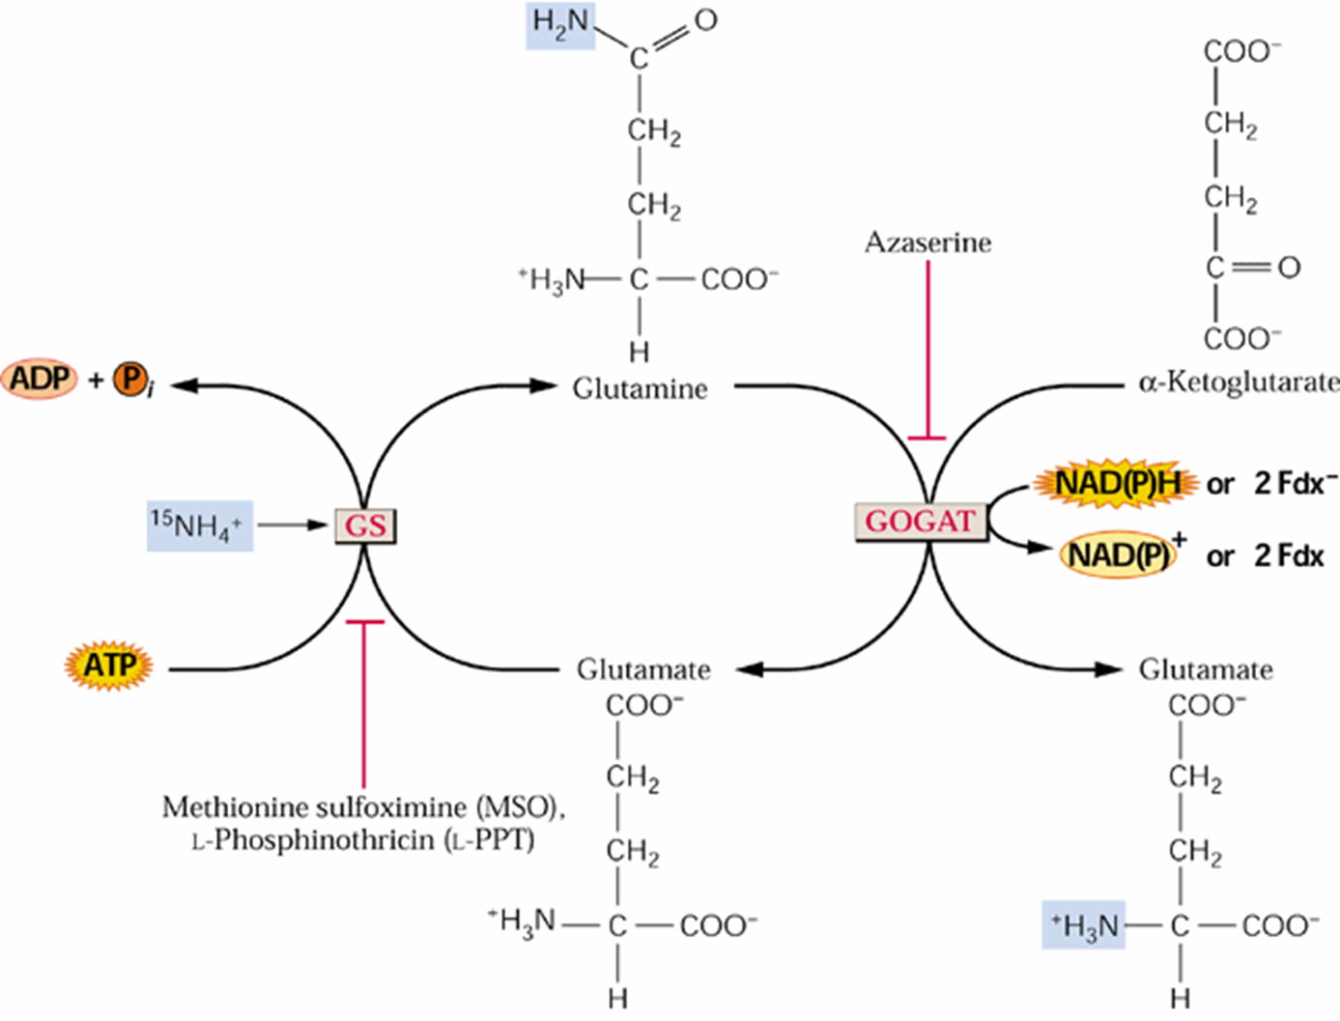
Glufosinate

Slide 8
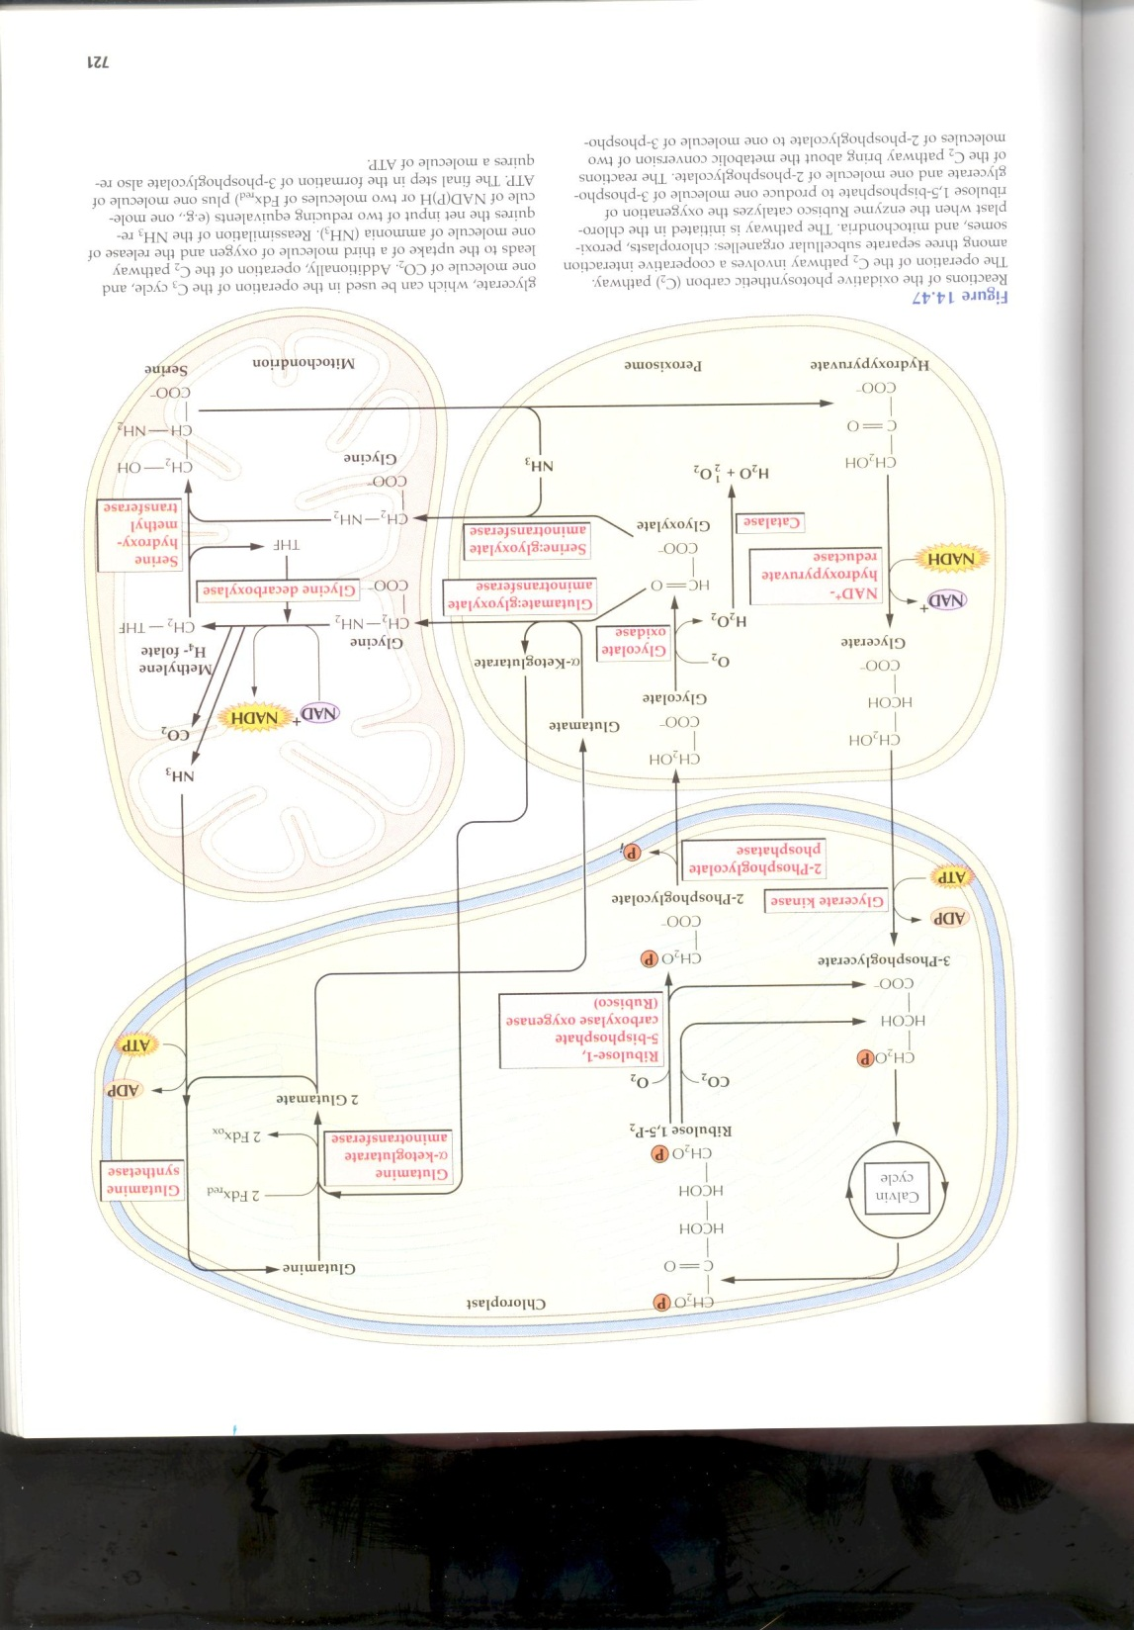

Slide 9
Irreversible binding within the pocket, prevents substrate binding

Slide 10
Glufosinate
Liberty Link Crops
enhanced metabolism is the tolerance mechanism of resistant crops
insertion of bar (phosphinothricin acetyl-transferase) gene from Streptomyces hygroscopicus

Slide 11
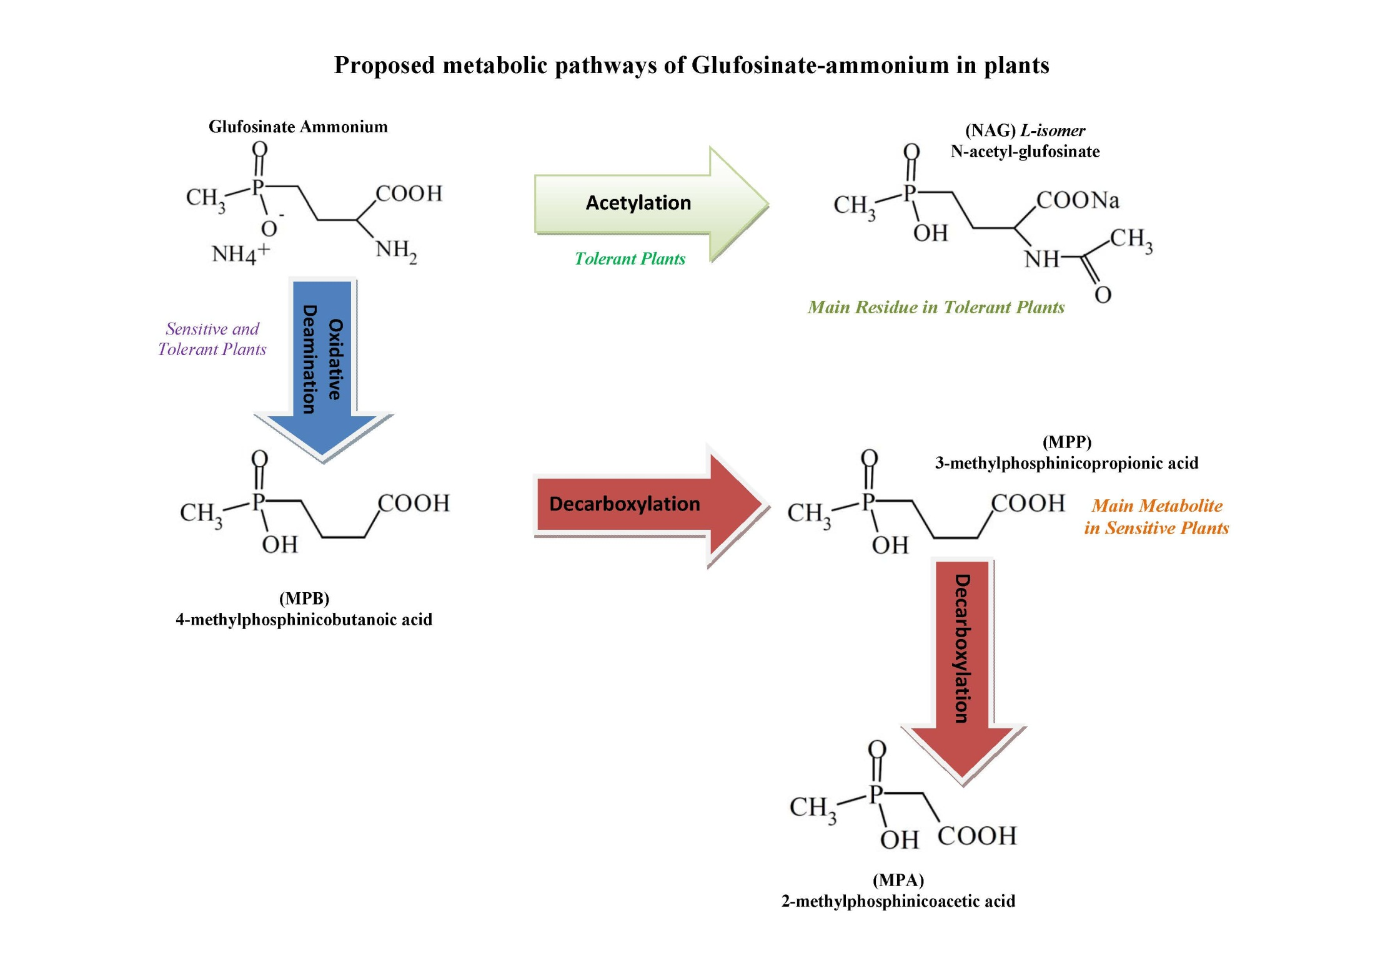

Slide 12
Glufosinate
Resistance in weeds
  First reported case in the U.S. was Italian ryegrass
  Amino acid substitution at position 171 in the target enzyme, glutamine synthetase (aspartic acid for asparagine)
  Not complete resistance, but an index of 2.8
Concern over pollen transmission of resistance from crop to weeds (rice, canola)

