Slide 1
Herbicide History and Discovery
Herbicide/Plant Interactions
PLS 6655

Slide 2
Herbicide Definition
technically anything from a chemical basis that is used to kill unwanted plants
‘Herb’ – meaning plant
‘Cide’ – meaning to kill
generally organic in chemistry
specifically developed for selective or non-selective weed control

Slide 3
Herbicide History
first reported cases of chemical weed control - Rome sacked Carthage and salted the land; Old Testament – Judges 9:45 Abimelech sowed salt on the fields of Shechem after defeat
Copper sulfate (1896) used for disease control in grapes, noticed control of mustard
Bolley and Schultz (late 1800’s), weed control in cereals with various copper salts
DNOC first organic herbicide patented by Truffaut and Pastac in 1932 for cereals
Simultaneous discovery of 2,4-D by US and British plant physiologists in 1943

Slide 4
Herbicide History
Arsenic salts – both mercuric (Mg) and lead (Pb) arsenic were used for aquatic and nuisance vegetation control
NaCl (salt) used for total vegetation control, rights-of-way, railroads, etc.
H₂SO₄ used for many years for aquatic weed control – inject into flowing water
Mineral spirits (Stoddard’s solvent) for weed control in carrots

Slide 5
Chemicals Evaluated Prior to 1942

Slide 6
Herbicide Classification
1) chemistry - molecular structure, widely accepted, in place for years
a) nearly all herbicides generated by organic chemists, structures are how chemists relate information (IUPAC)
b) subtle changes in chemistry will affect results (substitutions of side groups)
2) cropping pattern
3) weed spectrum
4) mode of action (physiological activity)

Slide 7
Terms to Define ‘Action/Activity’
mode-of-action - the sequence of events that occurs prior to, and directly after interaction of the herbicide with the active site
mechanism-of-action - the activity of the herbicide with the target site that leads to an observable result in a plant
herbicide selectivity - different plant species, or even varieties, do not respond the same to a particular herbicide at a particular rate

Slide 8
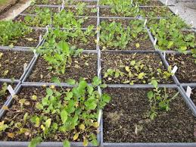
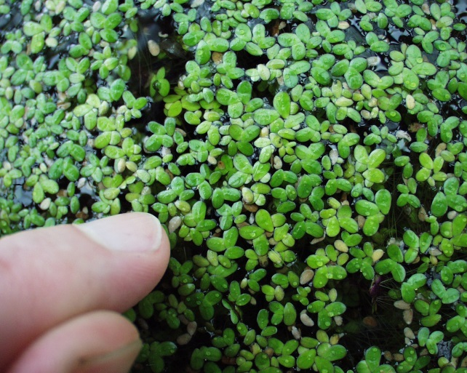
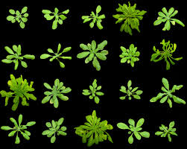
Herbicide Discovery – Screening to Detect Activity
Traditional screening of whole plants
thousands of compounds
generated by organic chemists
screened in whole plant studies, 20-100,000+ compounds per year
1 dicot, 1 monocot (also Arabidopsis, Lemna)

Slide 9
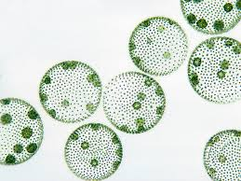
Other Screening Techniques Algae
algae - cell count, chlorophyll analysis, O2 evolution
advantages - easy to determine cell count
centrifuge and re-suspend to remove herbicide…
accumulate lipophilic compounds (useful for environmental monitoring)

Slide 10
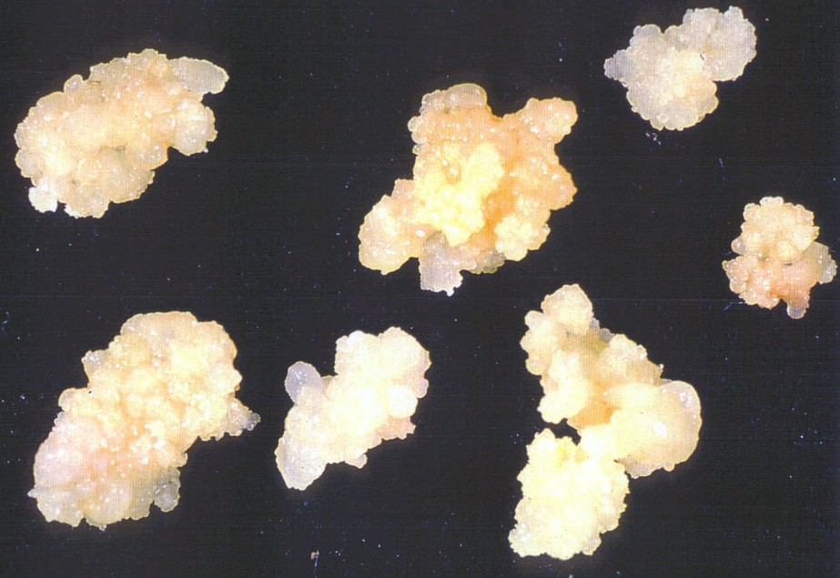
Other Screening Techniques Heterotrophic Higher Plants
tissue culture/cell suspension
growth parameters provided
Sucrose
Hormones
Vitamins, etc.
Used to detect growth effects, abnormalities

Slide 11
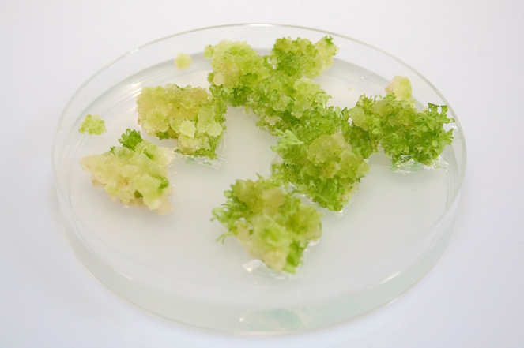
Other Screening Techniques Autotrophic Higher Plants
tissue culture
often used in metabolism studies
provide homogeneous tissues for comparison

Slide 12
Why Still Use Whole Plants?
no single, fast screening procedure (i.e. lab based) will detect all herbicides
this technique also provides all the physiology, biochemistry to allow the herbicide to work
Algae – misses auxins, VLCFA inhibitors
Heterotrophic – no complex tissues formed
Autotrophic - many don’t grow, without complex plant tissues, still miss some activity
But times are a changing………………..

Slide 13
Chemical based, Combinational Chemistries
essentially libraries of structurally related compounds, computer simulated and/or synthesized (mixture)
used extensively for years in pharmaceutical industry
limited use for herbicides
limited amount of chemical produced –
couldn’t use in whole plant screening (mixture of compounds screened at same time)
advances in high-throughput screening allow this technique to be used
miniaturized systems (microtiter plate)
in vitro assays

Slide 14
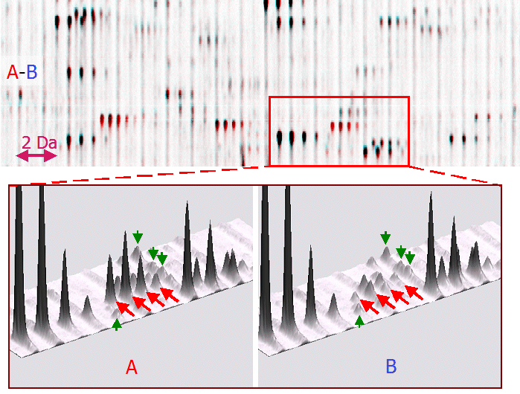
Target Based Discovery
utilize genome sequencing data, identify a target enzyme and essentially build a herbicide to inhibit/impact
recent assessments predict about 5000 potential target sites within plants
Differential display is one frequently used method
Look at response
Compare to known herbicides
However, must have the gene sequence…

Slide 15
Limitations to Target Based
Will inhibition cause a retardation of growth or kill the plant?
Can you obtain enough enzyme, in the right form to perform the assays, cDNA clone to be able to express in a eukaryotic expression system?
Can use accurately measure the activity of the enzyme, how will you measure?
Is there sufficient information on the active sites, regulatory sites, of the enzyme?
If you can satisfy these criteria, then utilize HTS techniques to identify potential inhibitors.
Can also compare protein sequences of enzymes between species to identify possible selectivity

Slide 16
Unknown Protein Targets
non-enzyme based targets, regulatory, transcriptional factors, signally proteins, etc.
reduce expression of genes through the introduction of a reverse copy of the gene (RNAi or antisense RNA), or through double stranded RNA segments, plant senses something is wrong and degrades the transcripts along with the normal ones being produced, observe the impact and if negative, work backwards to identify possible target based inhibitors
DNA sequences from genome sequencing projects can be compared to known database to determine function of an unknown gene that could turn out to be a possible target

Slide 18
Determination of the Mode of Action
During traditional screening this was not needed
often public institutions discovered mode of action years after registration and herbicide use
no need as long as it passed all other tests
however MoA profiling is performed very soon after activity to help shorten time in development
reduce time chasing false leads

Slide 19
In vitro & In vivo Techniques
purpose is to find first clues about the mode of action
these are compared with known herbicides
build a database for comparative purposes – essentially profiling the compound
Combination of holistic and physiological tests

Slide 20
Examples of Assays
Callus cells in suspension – measures cell division
Algae suspension – measures growth
Lemna whole plant assay – increase in frond number
Cress germination – whole plant assay
Shoot bioassay – fresh weight changes over time
Photosystem impacts – isolated thylakoids from wheat, spectrophotometrically determine ferricyanide formation
Germination – seedling cress treated with water soluble dye to determine cuticle formation – assays for F.A. synthesis inhibition
CO₂ uptake – gas analysis in a closed system - photosynthesis
Respiration – oxygen consumption
Uncoupler – whole plants, treat with mitochondria sensor dye and measure changes in fluorescence microscopically
Reactive oxygen species – fluorescence, spectrophotometric assays

Slide 21
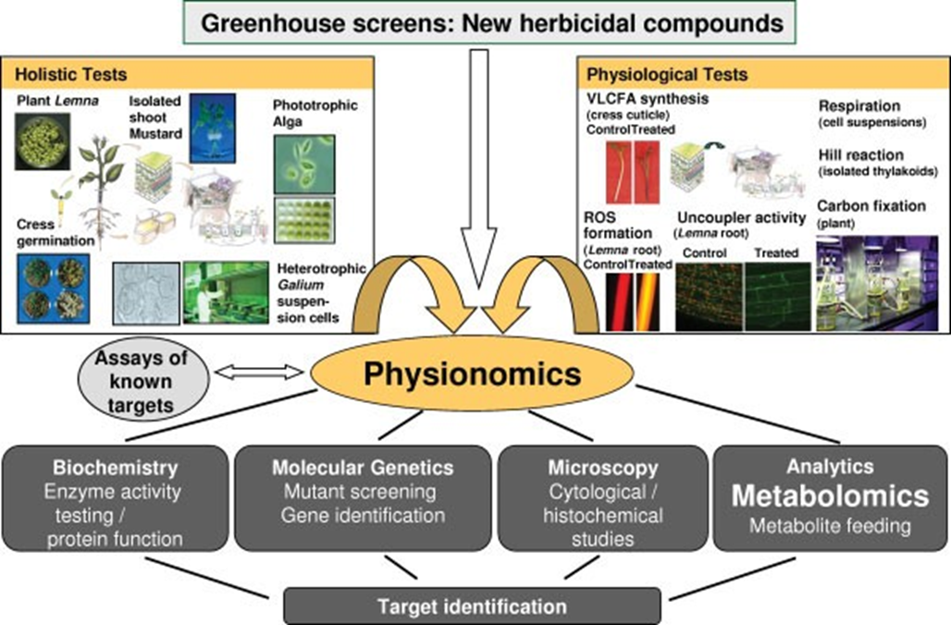
From Grossman et al., 2012. Physionomics and metabolomics – two key approaches in herbicidal mode of action. Pest Management Science. 68:494-504.

Slide 22
Molecular Techniques
Microarrays are used to measure changes in gene expression; cDNA’s (gene fragments) are placed on a solid block and hybridized with labeled RNA extracted from treated or untreated plant tissues/cells.
The strength of the hybridization tells whether the gene has been up or down regulated. These are compared to libraries of herbicides with known mode of action.
Protein arrays can be used for similar results, but often used with RNAi to fine tune which gene is being affected.

Slide 23
Metabolomics
Identification and quantification of metabolites through gas or liquid chromatography and mass spectrometry analysis
Essentially profile the changes in metabolite expression and compare to libraries of known compounds.
Requires intensive statistics – multivariate analysis such as prediction analysis of microarrays (PAM) and partial least squares-discriminate analysis (PLS-DA) to determine the degree of differences between treatments and the controls

Slide 24
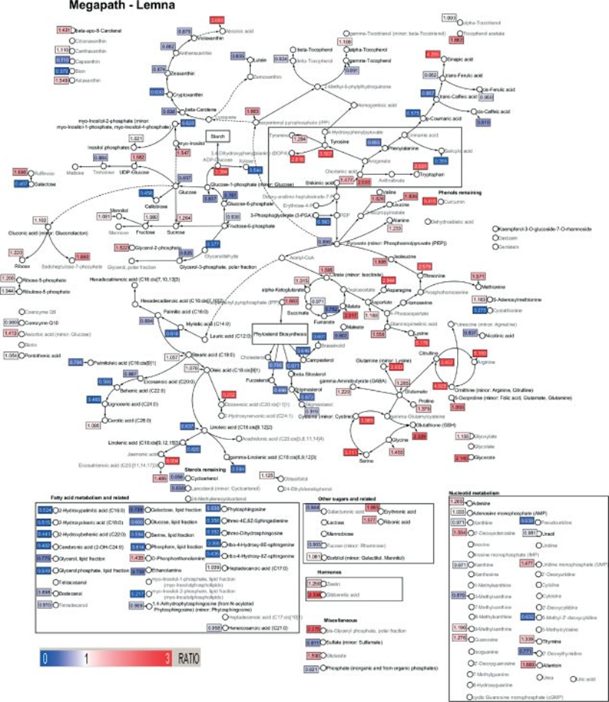
Figure 3. Metabolic profile in Lemna paucicostata plants treated with 0.3 µM ISO1 for 72 h. Changes in identified metabolite concentrations were visualized as ratios, relative to the control, in a biochemical pathway view. Metabolites in pathways with flags in red indicate an increase in levels, and with flags in blue a decrease in levels, relative to the control. The numerical ratios of changes in metabolite levels are given in the flags. A hypothesized site of pathway interference is marked with a border.

Slide 25
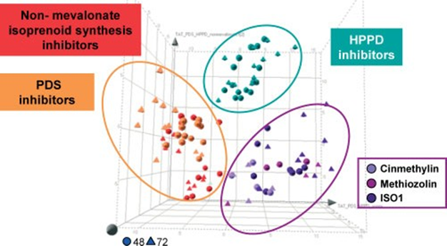
Figure 2. Mode of action classification by cluster analysis of metabolite changes using PLS-DA. In Lemna paucicostata plants treated with 0.1, 0.2 and 0.3 µM cinmethylin, methiozolin and ISO1 for 48 and 72 h, changes of ca 200 identified and ca 300 unknown analytes, relative to the control, were determined. Testing for profile assignment to the mode of action classes of 4-hydroxyphenylpyruvate dioxygenase (4-HPPD), phytoene desaturase (PDS) and non-mevalonate isoprenoid synthesis inhibitors (represented by three inhibitor standard herbicides of each mode of action, applied in three concentrations for 48 and 72 h) was performed using multivariate clustering analysis by partial least-squares discriminant analysis (PLS-DA). PLS-DA constructs an empirical model that relates treatment, as observation (class variable) with analytes, as an x-type variable. The model is visualized as a score plot where each point represents an individual sample. The predictability of the model, indicated by the Q2 value, is 87%.

Slide 26
Quantitative structure-activity relationships (QSAR)
correlates biological activity with chemical structure, several parameters used
octanol/water partition coefficient - membrane partitioning
pKa - phloem mobility
electronic characteristics (charge)
substitute groups and observe activity, develop mathematical (regression) equations to predict activity
however, system by system basis, cannot be extrapolated to others
many times these are used in in vitro assays, don’t relate to whole plants
used to change activity, not mechanism of activity
this technique has fallen out of favor in the past 10-15 years with the advent of newer technologies, but still has relevance in current screening, particularly fine-tuning to reach the actual molecule and/or formulation that provides efficacy and selectivity needed
Clark, R.D. 2012. A perspective on the role of quantitative structure-activity and structure-property relationships in herbicide discovery. Pest Manage. Sci. 68:513-518.
Li, Z.M. 2012. The structure-activity relationships in herbicidal monosubstituted sulfonylureas. Pest Manage. Sci. 68:618-628.

