Slide 1
Photosynthetic Mechanism
overview

Slide 2
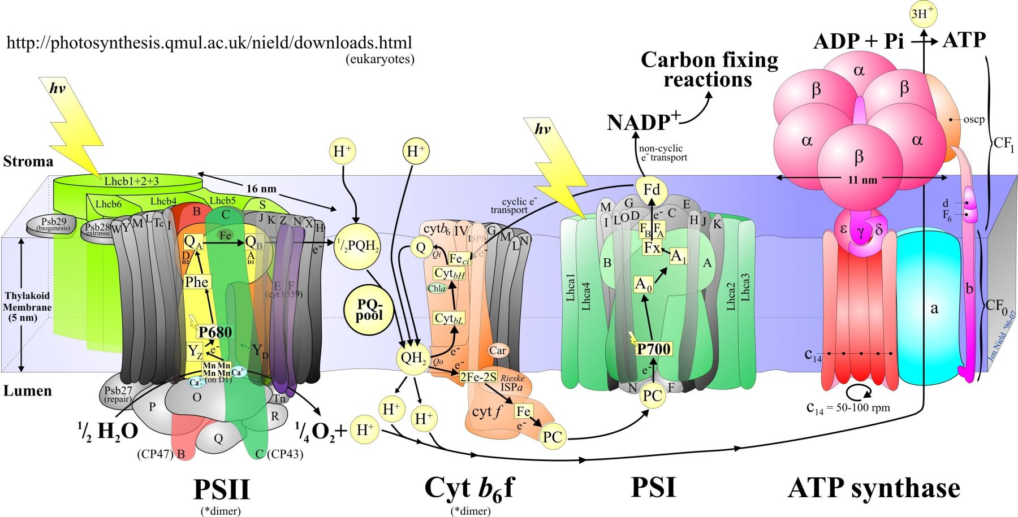

Slide 3
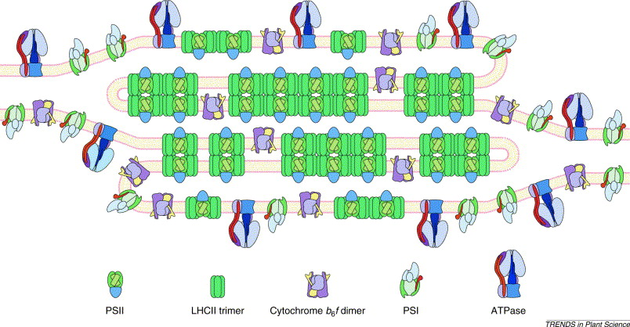

Slide 4
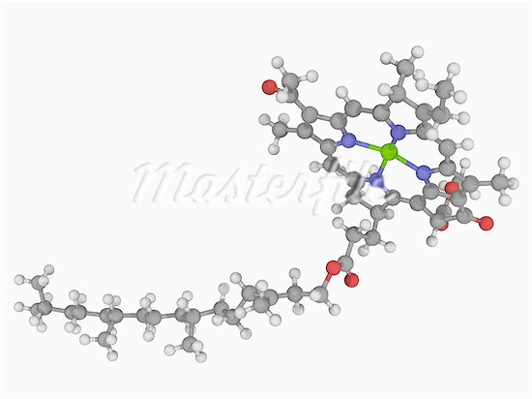
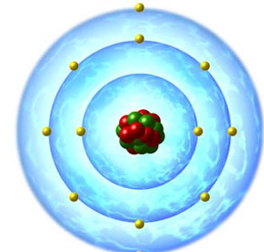

Slide 6
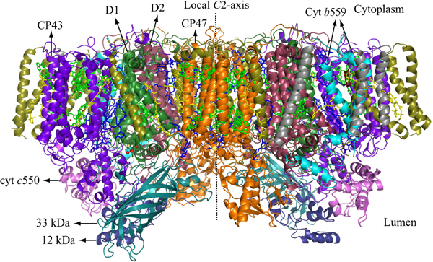
Photosystem II Complex

Slide 7
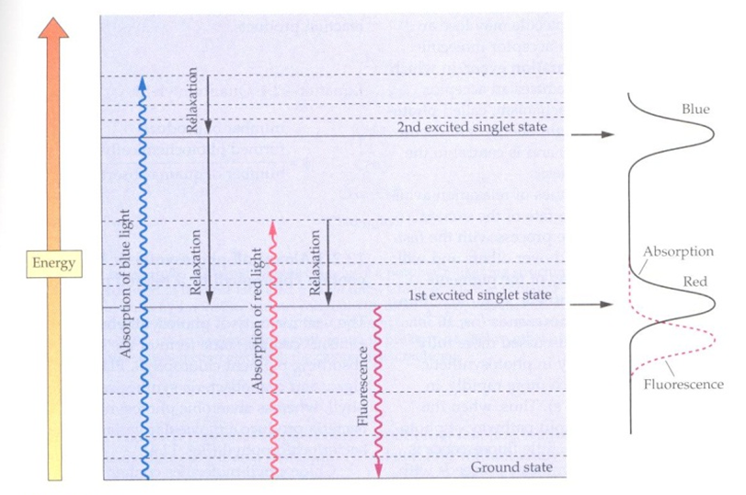

Slide 8
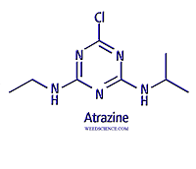
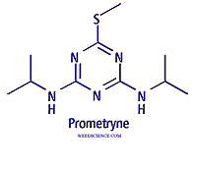
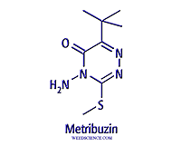
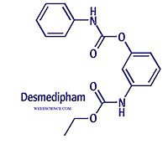
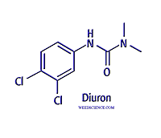
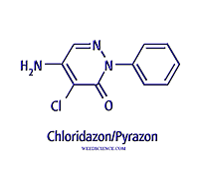
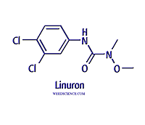
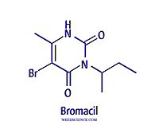
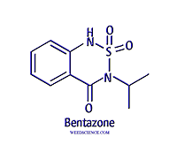
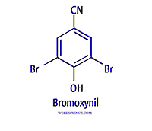
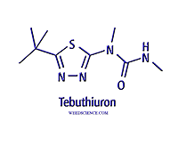
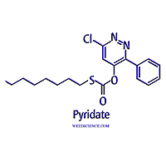
Photosynthetic Inhibitors

Slide 9
Photosystem II Inhibitors C1, C2, C3
Phenylcarbamates – desmedipham, phenmedipham
Pyridazinones – pyrazon
Triazines – atrazine, simazine, prometon, prometryn (15)
Triazinones – hexazinone, metribuzin, metamitron
Triazolinone – amicarbazone
Uracils – bromacil, terbacil, lenacil
Amides – propanil
Ureas – diuron, linuron, fluometuron, tebuthiuron (22)
Benzothiadiazinones – bentazon
Nitriles – bromoxynil (3)
Phenyl-pyridazines – pyridafol, pyridate

Slide 10
History
Initial discoveries of triazines in mid 1950’s
Initial discoveries of ureas in mid 1950’s
Several companies - Ciba (Syngenta) & DuPont
Used on a wide range of crops and cropping systems
Primarily broadleaf control but some have excellent grass activity
Registrations in 1950 through 1970’s, few since

Slide 11
Mode of Action
Primarily soil applied with root uptake via the xylem, translocated to leaves and shoots
Several however can be applied to foliage but act as contact herbicides – no translocation
Limited water solubility for most, but some pose groundwater concerns – generally weak bases

Slide 12
Mechanism of Action
Common features to all PSN inhibitors are unique bonding (–CO–N<, –N==C–N< )
Herbicide binds to the QB plastoquinone binding site of the D1 protein in photosystem II
Compete for binding with the plastoquinone within the QB binding niche

Slide 14
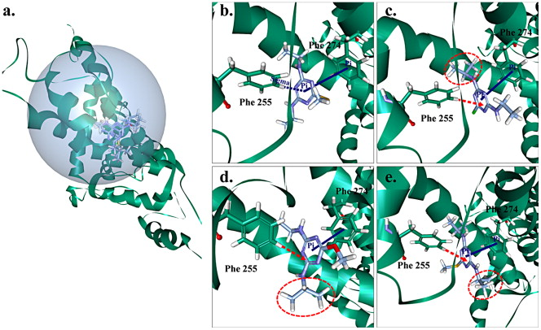
b. Simetryn
c. Atrazine
d. Prometon
e. Prometryn
Hongming Ge , Zhifen Lin , Zhifeng Yao , Ya Gao , Yongping Cong , Hongxia Yu. 2014. Balance between herbicidal activity and toxicity effect: A case study of the joint effects of triazine and phenylurea herbicides on Selenastrum capricornutum and Photobacterium phosphoreum. Aquatic Toxicology, Volume 150, 2014, 165 - 174

Slide 15
Takahashi et al, 2010. Structures and binding sites of phenolic herbicides in the Qb
Pocket of photosystem II. Biochemistry 49:5445-5454.

Slide 16
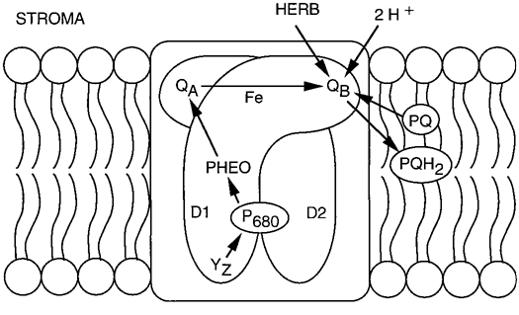
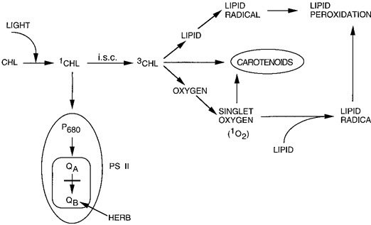
Mechanism of Action
Blockage of electron flow inhibits formation of ATP and NADPH₂
Formation of radical molecules in response to excess energy

Slide 17
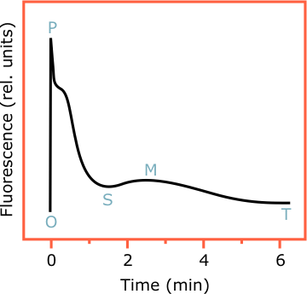
PSN inhibitor
normal

Slide 18
Selectivity
Placement in perennial systems, herbicides remain in upper soil profile, do not reach roots
Metabolism for many crops
Glutathione conjugation in corn, cereals
Oxidation via monooxygenases
Deamination via monooxygenases

Slide 19
Resistance
Evidence from resistance strongly indicates differences in binding characteristics of the 3 classes of PSII inhibitors (color scheme)
Lack of fitness associated with resistance, reduced photosynthetic efficiency
Position | Substitution | PS II Class | Species
219 | Valine to Isoleucine | Diuron C2, metribuzin C1 | Poa annua
219 | Valine to Isoleucine | Diuron, tebuthiuron C2, metribuzin C1 | Kochia scoporia
264 | Serine to glycine | Atrazine C1 | Chenopodium album
264 | Serine to Threonine | Atrazine C1, diuron C2 | Portulaca oleraceae
266 | Asparagine to Threo | Bromoxynil C3 | Senacio vulgaris

Slide 20
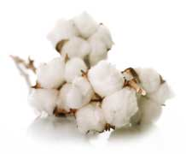
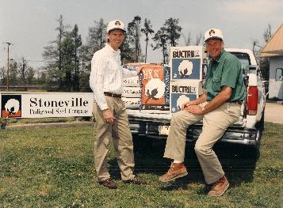
Genetic Engineering
BXN Cotton – mid 1990’s, no longer available
Inserted a gene from Klebsiella ozaenae that encodes a bromoxynil nitrilase enzyme that degrades bromoxynil

Slide 21
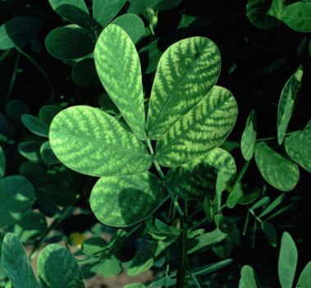
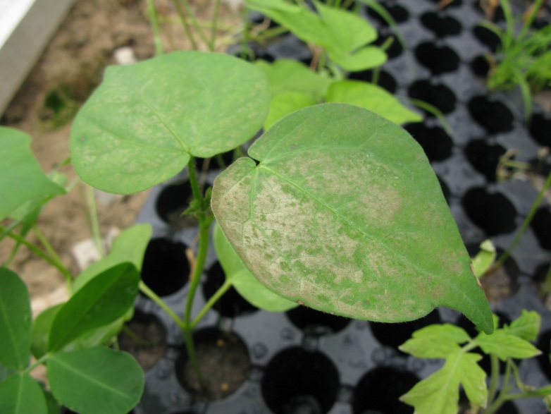
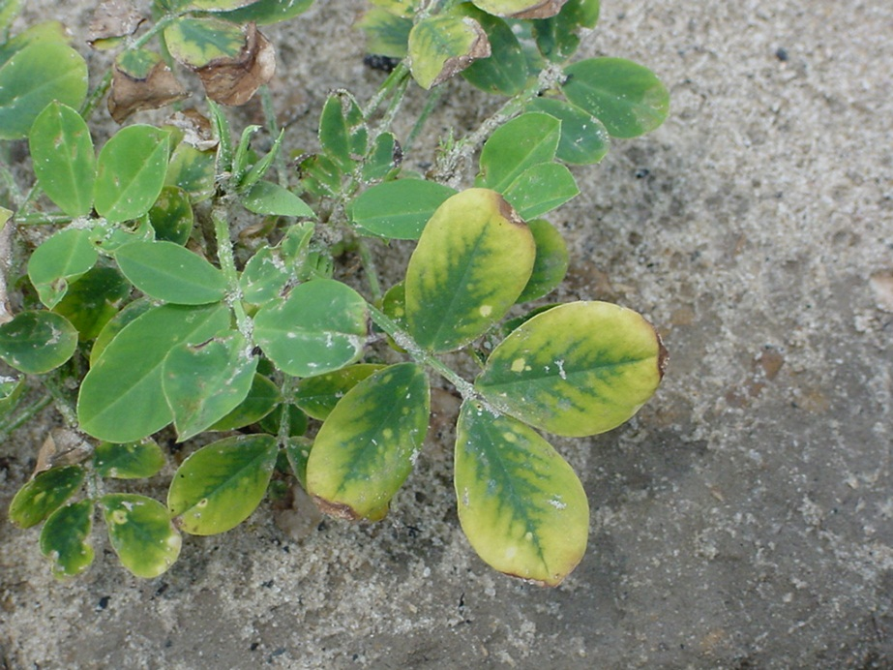
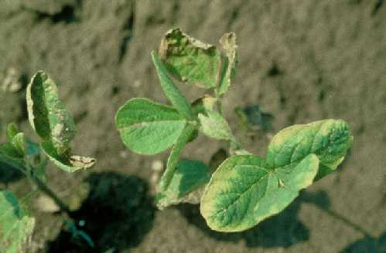
Symptomology

Slide 22
