Slide 1
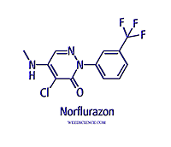
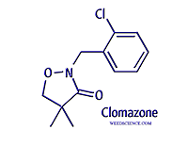
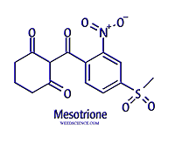
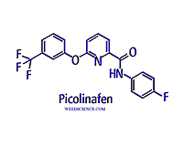
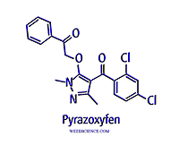
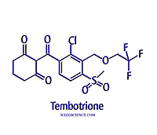
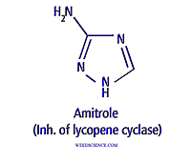
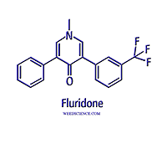
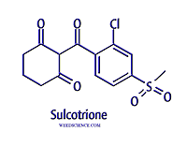
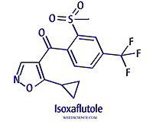
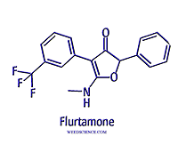
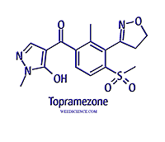
Pigment Inhibitors

Slide 2
Pigment Inhibitors
Phytoene desaturase
Pyridazinones, Pyridinecarboxamides, Others
4-HPPD
Callistemones, Isoxoles, Pyrazoles, Triketones
Unknown target sites
Triazoles, isoxazolidinones, diphenylethers

Slide 3
History
Amitrole first discovered in 1953
Norfluazon and fluridone in 1968 and 1977, fluridone registered for aquatics in 1986
Clomazone in 1985
Isoxaflutole and mesotrione in mid 1990’s and early 2000’s
Recent registrations include tembotrione and topramezone

Slide 4
Pigment Inhibitors
Predominately soil applied and translocated via the xylem (apoplastic)
Limited movement in phloem, although amitrole and mesotrione appear to have some phloem mobility
Broadleaf and grass activity
Wide range of crops – soybeans, corn, cereals, cotton
Clomazone very volatile, others soil persistent

Slide 5
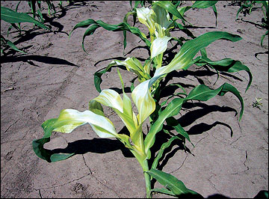
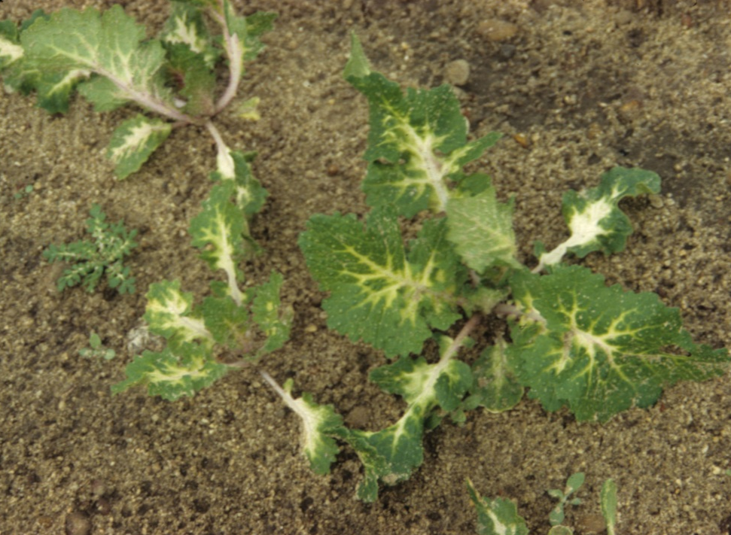
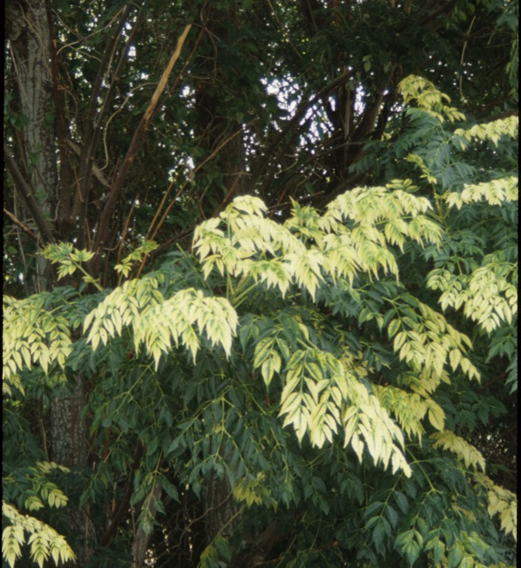
Symptomology

Slide 6
Mechanism of Action
Block pigment formation, primarily carotenoids
Carotenoids function to accept excess energy from chlorophyll, dissipating as infra-red (heat)
Chlorophyll cannot get rid of excess energy, photo-oxidizes
Results in bleached tissue, or sometimes pinkish red tissue – due to anthocyanins

Slide 7
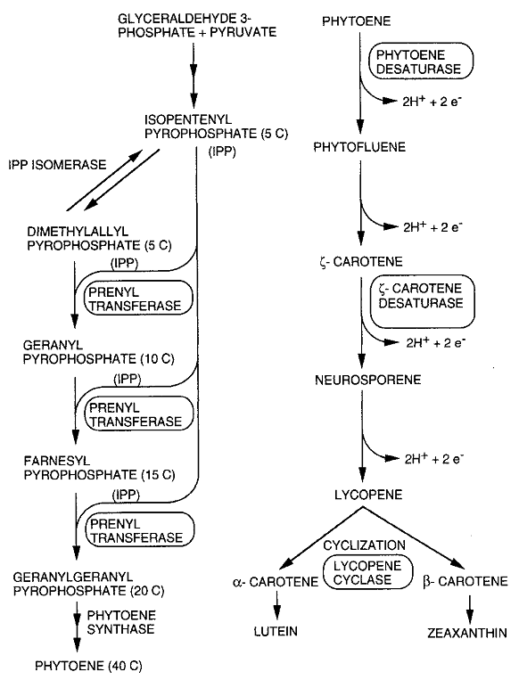
Fluridone, norflurazon
Amitrole
Clomazone

Slide 8
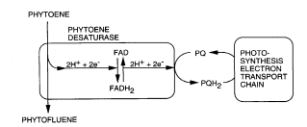
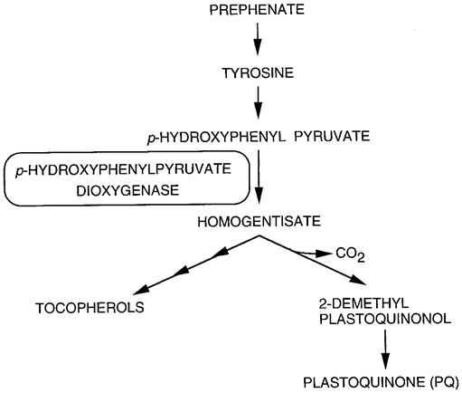
4-HPPD inhibitors

Slide 9
Selectivity
Primarily metabolism
Oxidation via monooxygenases
Clomazone selectivity can be achieved via organophosphate insecticides, preventing metabolism to active compounds – cotton

Slide 10
Resistance
Fluridone resistance in hydrilla
Single amino acid substitution
Confers 2 to 7X tolerance
Cross resistant to other phytoene desaturase inhibitors

