Slide 1

Formulations, Adjuvants, Surfactants, etc.
‘anything else beside water and the active ingredient’
*Acknowledge Jerry Green – Dupont (Florida Weed Science Society presentation in 2003) for several slides in this lecture set
FWSS
2003

Slide 2
Influence of Formulations and Adjuvants
Formulation/Spray Tank
  Compatibility
  Solubility
  Stability
  Foaming
  Safety
Atomization
  Droplet Size
  Evaporation
Deposition
  Reflection
  Adhesion
Form of Spray Deposit
  Spreading/Wetting
  Physical Form
Penetration/Uptake
  Hydrophilic
  Lipophilic
  Stomata
Translocation?
Notes:
One of our standard ways to look at adjuvants where we list the various aspects of the application process that
formulations and adjuvants influence:
Formulation/Spray Tank: compatibility, solubility, stability, buffering, and foaming.
Spray atomization: drift and evaporation
Spray Retention: reflection and adhesion
Deposit modification: including wetting, spreading, physical form of the deposit, and effects on the solubilization of the ingredients in the deposit and the leaf surface components
Penetration:
and we can debate later whether adjuvants influence
TRANSLOCATION DIRECTLY.

Slide 3
Categories of Recent Trends
Increasing/Decreasing pH
Repellants and Adherents
Foams and Anti-Foams
Improved Efficacy
Physicochemical Properties
Improved Targeting
Controlled Release
APE Replacements
Nanotechnology
Deposition/Drift
Microemulsions
Seed Treatments
Coatings
Stabilizers
Soil Performance
Bioherbicides
Safety
Notes:
This slide shows some of the many categories of patent applications for adjuvants and formulations made during the last two years.
I will review some these categories today.

Slide 4
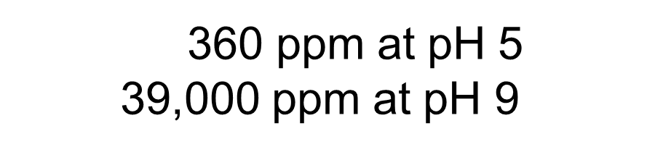
Do you need to modify your pH?
Spray water and formulation pH varies greatly and affects:
Ionic State / Compatibility
Stability
Solubility
Biological Activity
Hard Water Antagonism
pKa = 4.3
⁺ H⁺
Notes:
A common theme today for both pesticide and adjuvant formulations is to modify the pH.
There are products that
acidify or lower pH,
raise pH or make alkaline, and
some buffer at neutral pH.
Changing pH can change the ionic state of the pesticide,
its compatibility with other pesticides,
Stability,
solubility,
Biological activity and
hard water antagonism!
...

Slide 5


Herbicides can modify pH
Glyphosate acid
pH < 2
Glyphosate mono-salt
pH 4.4 to 5.0
Glyphosate di-salt
pH 6.7
Notes:
Maybe the most impact of pH is with the various glyphosate formulations.
You can tell the pH of glyphosate if you know whether it is an acid, mono-(substituted) or di-salt.
All of the above at commercial products.
(read slide)
Someday we may see an alkaline glyphosate because you can make a tri-substituted salt!
Glyphosate has 4 dissociation points, it primarily
acid < 2.2, mono-salt < 5.8, tri-salt < 10.2,
and gets rid of positively charged nitrogen above 10.5 above
4 ionization points at pH 0.3, 2.2, 5.6, 8 and 10.2

Slide 6
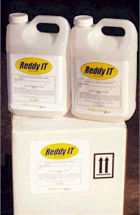




Adjuvants can Modify pH
Basic Blends
Compatibility Agents
Tec'N Tank
™
Fertilizer Solutions
Water Conditioners
Reddy IT
™
Notes:
Lots of adjuvants modify pH too!
pH modification is important for many different functions.
Sometimes adjuvants clearly indicate they modify pH,
Sometimes adjuvants promote they modify pH, BUT
MOSTLY adjuvants do not indicate that they modify or buffer pH!
DO NOT ASSUME that anything you add to a spray mixture is pH neutral.
Agrochemicals are fighting to control the pH of the spray tank!

Slide 7
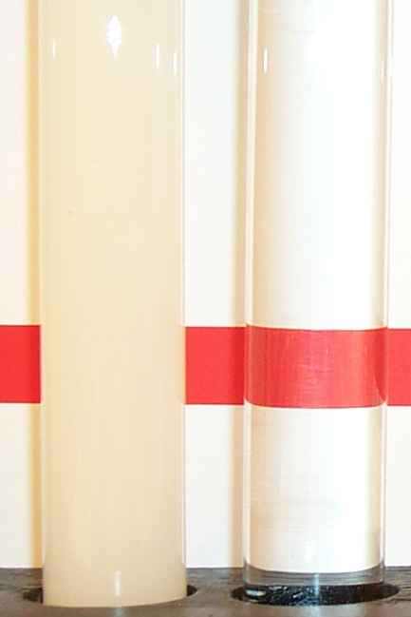

SG Formulations of Sulfonylurea Herbicides
A new paste-extruded sulfonylurea herbicide formulation that is water soluble and thus improved spray equipment clean-out properties and weed control.
Reference:
Keenan, J. J., L. M. Pugh, and R. T. Roche. 2003. Manufacture of paste-extruded sulfonamide herbicidal compositions. U.S. Patent Appl. 468706.
Ally 20 DF 1% in Water
Ally 20 SG 1% in Water
Notes:
We can see the effect of pH on solubilization!
On the left,
The low pH spray mixture is a dispersion of small particles.
The water looks cloudy because it has small particles dispersed in it.
On the right, the higher pH solubilizes the herbicide particles.
The water is clear and is fully dissolved.
It is a true solution.

Slide 8
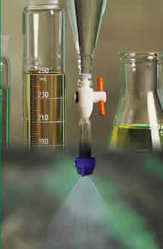

Helena patented method to increase the solubility of agrochemicals at low pH to produce liquid concentrates with amine surfactants and organic acids.
2,4-D
Reference: Volgas, G., Roberts, J. R., and Hayes, A. 2002. Agricultural formulation. U.S. Patent Application 10/081,627.
Notes:
As a final point on pH,
Helena has also applied for patents with low pH technology to make glyphosate and other herbicides compatible with important adjuvant technology.
They can acidify a weak acid herbicide like 2,4-D and make it neutral so they can load it at high concentrations in the oily inside of surfactant micelles. These formulations are concentrated with the odor/volatility and fertilizer compatibility issues. It is also reported to be more biologically active.

Slide 9
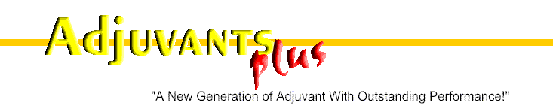
Reddy IT
Reddy IT™ Tec 'N Tank™
Spray Activator
Adjuvant composed of surfactant (phosphate ester and amine ethoxylates), methylated seed oil, and other ingredients at low pH to allow direct formulation of glyphosate acid into spray water with high efficacy.
Reference: Stewart, J. F. and Brown, W. G. 2004. Agrochemical formulation aid composition and uses thereof. U.S. Patent Appl. 20040077501.
Notes:
If you use pH correctly to dissolve the herbicide, you do not have to formulate the herbicide.
This has been commercialized in Canada.
Tec ‘N Tank let’s you put unformulated “technical” directly in the tank.
If you can buy technical near the manufacturing costs, this approach could save you a lot of money.
Penner, D., Michael, J., Brown, W. G., and Sikkema, P., 2003. Biologically active in-tank formulation of acid herbicides. Pesticide Formulation and Application Systems: 23rd International Symposium, ASTM STP 1449, G. Volgas, R. Downer, and H. Lopez, Eds. ASTM International, West Conshohocken, PA.

Slide 10

Gramoxone® Inteon™
Alginate formulation that gels at very low pH and prevents absorption in the stomach.
Combines gel, emetic, purgative, and odorant to prevent accidental death by ingestion.
Reference:
Atkins, J. M., Foresman, C., Vitolo, D. B., Clap, M. J.L., Heylings, J.R., 2005. Gramoxone® Inteon: Innovative formulation technology to reduce hazard potential. Proceedings Weed Science Society of America 45:363.
Notes:
A new paraquat formulation with more than 10-fold less oral toxicity has just been commercialized (Atkins et al., 2005). This patent pending formulation is based on alginate, a seaweed extract composed of a non-toxic carbohydrates commonly used in food and pharmaceuticals. Alginate gels under very acidic conditions so even if ingested, it will gel in the stomach and paraquat absorption will be greatly reduced. This formulation also contains an emetic and purgative agent to further reduce absorption. Thus, three processes (gelling, emesis, and purgation) act together to greatly reduce the toxicity of paraquat if it is ingested accidentally or deliberately. The formulation also has an offensive odorant to discourage ingestion.
Emetic – induces vomiting
Purgative – purge from bowels

Slide 11
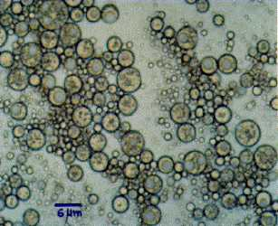
New Bioherbicide Formulation
WOW Formulation or water in oil in water emulsion. It is < 5% oil with microscopic oil droplets in continuous water phase.
References:
Auld, B. A. 2002. Bioherbicidal formulation. Australian Patent Appl. 952,094.
Auld, B. A., Hetherington, S. D., and Smith, H. E. 2003. Advances in bioherbicide formulation. Weed Biology and Management 3:61-67.
Notes:
As we all know, biologicals can be very susceptible to degradation.
This is a “WOW” formulation! “WOW” means great excitement in English. I am not sure this formulation will bring great excitement. The “WOW” means forming a water droplet inside an oil droplet that is in water.
It gives you the opportunity to put you active inside the innermost droplet and protect it.
A biological pesticide may need that protection.

Slide 12
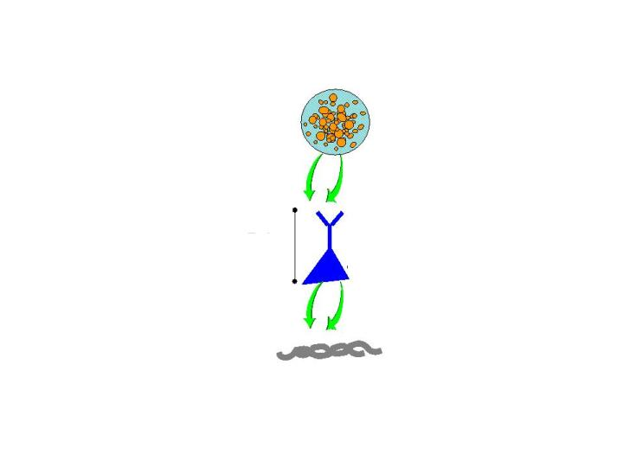
Biotechnology for Site Specific Targeting
Microcapsule
Use camelid antibodies to develop a ‘fusion’ protein to carry a high load of agrochemical and bind at specific cellulose target.
Fusion protein
Reference:
Barnwell, S. G. and Parry, N. J. 2003. Carbohydrate-binding domain-containing fusion protein for delivery of therapeutic compositions containing them. WO 200301477.
Target
Notes:
Biotechnology has made its way into the agricultural adjuvant world!
This is and interesting new development that definitely can be considered as bringing biotechnology to adjuvant technology.
You attach a protein to the pesticide that can specifically target or bind to the location on the plant that you want it delivered to! Biotechnology may help us get ‘specific targeting’.

Slide 13
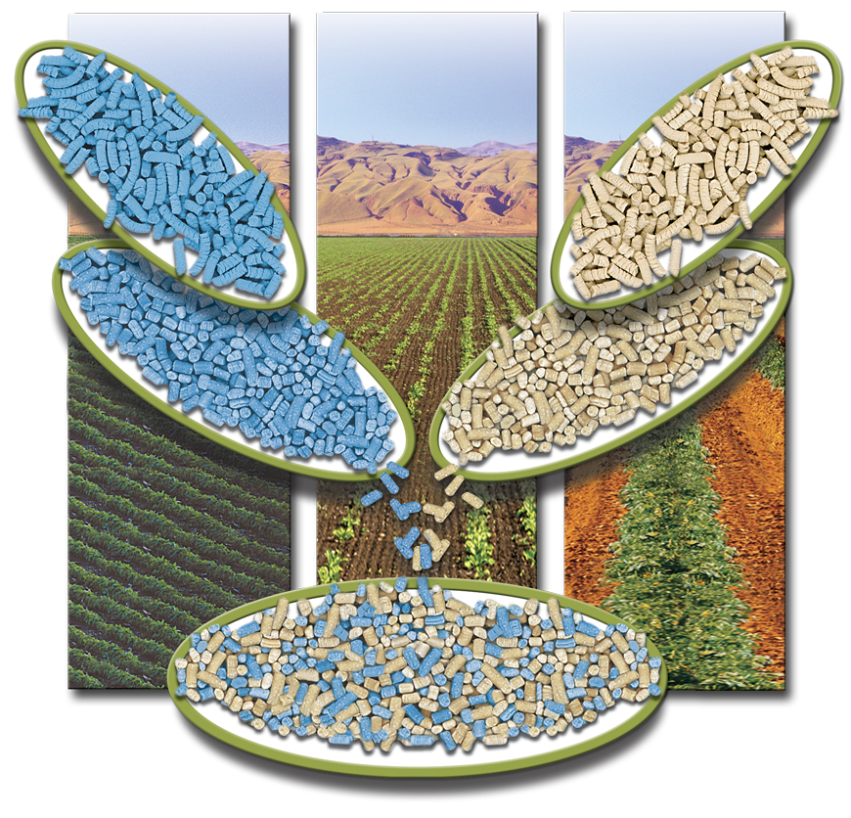
Homogenous Granular Blends
Make the
granules
Control
Size and
Breaking
Reference: Geigle, W. L and Gleich, S. I. 2001. Apparatus for breaking and separating particles. U.S. 6,270,025.
Notes:
This technology make uniformly sized granules with improved stability so that exactly formed blends can be made in small quantities to user specifications.

Slide 14
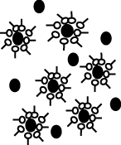
Microemulsions for Water Insoluble Herbicides
New microemulsion technology comprised of two nonionic surfactants that will microemulsify a wide variety of water insoluble herbicides.
Reference: Foerster, Class, and Wollenweber. 2001. U.S. Patent 6,255,253.
T. H. Anderson and P. M. McMullan. 2003. Biological Performance of Methylated Seed Oil Microemulsions. Presentation at ASTM.
Notes:
New microemulsion surfactant technologythat can microemulsify a wide variety of oil-phase chemistries under a wide range of conditions. It allows water insoluble herbicides to be formulated in water.

Slide 15
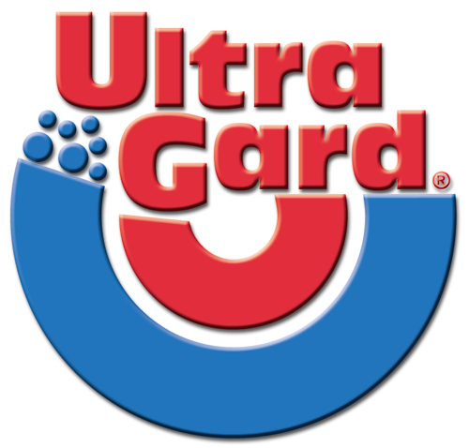
Introduced in 1995 and prohibited the use of tank-mix adjuvants!
Introduced later to provide the adjuvants Ultra needs:
Drift reduction
Defoaming
Water conditioning
Notes:
Without doubt, the biggest combination product was …
(read slide)
Today we have products that combine all these features into one product.
Combination products are often just for convenience.
Combinations can be convenient and help ovovercome mixing issues, but
often combination products are even more difficult to understand their chemical compositions
and
pesticide labels recommend adjuvant types, not combination types, so it can be more difficult to follow label instructions.

Slide 16
Surfactant/Adjuvant
Background
Hundreds available and sold in the U.S.
Represent approximately $400 million U.S.
$1 billion market world-wide
Not pesticides, so not subject to same rigorous testing by EPA and other agencies

Slide 17
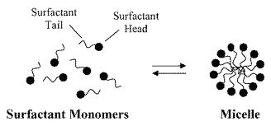
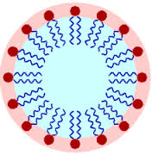
Properties
contain the properties of both hydrophillic & lipophillic molecules
able to interface with both types
essentially soaps

Slide 18
Hydrophillic/Lipophillic Balance
Defined as: HLB = 20 MH/[MH + ML]
range is 1 through 20
– where MH = molecular weight of hydrophillic segment
– where ML = molecular weight of lipophillic segment
High HLB (>11) - enhances diffusion of hydrophillic herbicides, through increasing the water holding capacity of the cuticle
Low HLB (<8) - enhances diffusion of lipophillic herbicides, through increasing the fluidity of the waxes in the cuticle

Slide 19
Potential Loss at Each Stage of Delivery
Drift : 15%
Rebound: 30%
Runoff: 20%
Five Types Drift / Deposition Aids:
Polymeric
  1) Polyacrylamide
  2) Starch-based (guar)
  3) Cellulose (EHEC)
Non-Polymeric
  4) Lecithin-based
  5) Evaporation retardants
Notes:
A few years ago, this slide was used to quantify pesticide loss from drift at 15%, rebound at 30%, and runoff at 20%.
I think we all would agree these processes are important but these numbers are not exact. They are interesting guesstimates for illustration.
There are four types of deposition aids:
2 polymeric: polyacrylamide and guar
And
2 non-polymeric: lecithin and evaporation retardants.

Slide 20
Deposition / Retention
D_{o}
D_{max}
2 msec
50 msec
Impact
Expansion
Retraction
No Guar
a.
Guar
b.
Reference: Bergeron, V., Martin, J-Y., and Vovelle, L. 2003. Use of polymers as sticking agents. U. S. Patent 6,534,563. Bergeron, V., Bonn, D., Martin, J-Y., and Vovelle, L. Controlling droplet deposition with polymer additives. Nature 2000: 405:772-775.
fffffff
fffffff
Notes:
One very interesting technology to control droplet bounce
is the guar-based adjuvant from Rhodia.
This adjuvant changes the viscosity or thickness of the spray droplets and prevent the bounce.
Some adjuvants are very good at influencing these processes.
Rhodia published a paper in Nature on guar that received a lot of attention and led to claims of up to 50% reduction in pesticide rates in the popular press. It made headlines when I was in Brazil at the IWCC and I was asked to comment on it.
Very interesting technology, but we are not ready to reduce pesticide rates that much yet.
Guar gum and guar derivatives along with fertilizer will control drift and enhance efficacy. These compositions are added to the spray tank.
US 6,534,563 Claims many types of polymers of specified flow and elongational viscosities. These include Polysaccharides, PV-OH, PV-phenylOH, EOs, POs, EO/POs, LS and many other polymer types. This next patent teaches a novel particulate sticker that is very interesting

Slide 21


Green Surfactants
Alkyl Polyglycosides (APG’s) are nonionic surfactants with hydrophilic saccharide and C₈₋₁₆ alkyl chain. APG’s have excellent adjuvant properties and can be put into concentrated dry formulations. They are made from renewable raw materials and have excellent ecotoxicology.
Reference:
Garst, R., Mueninghoff, J. and Schwan, M. J. Biologically Active Composition, U.S. Patent 5,550,115; WO 95/28410.
© Cognis Corporation, 2000
Notes:
Sugar surfactants are very safe and can be very effective. Their use is growing!
They are considered ‘green surfactants’ because they are safe to the environment.

Slide 22
Alkyl Phenol Ethoxylate or APE Replacements
Surfactants with alkyl amine alkoxylates neutralized with aromatic sulfonic acids.
  Reference: Shannon, T. T., Moore, C. E., and Chow, V. S-C. 2003. Pesticide formulations containing alkoxylated amine neutralized aromatic sulfonic acids. U.S. Patent 6,521,785.
Alkyl amine alkoxylates neutralized with tristyrylphenol ethoxylate sulfate.
Reference: Moore, E. C., Chow, V. S-C., and Hopkinson, 2002. Pesticide formulations containing alkoxylated tristyrylphenol hemi-sulfate ester surfactants. U.S. Patent Application 58,697.
Notes:
Because of a “perceived” toxicity issue, we see patents for Alkylphenol ethoxylate replacements.
These are new chemistries being promoted to be just as good as alkyl or nonyl phenol surfactants.
This patent and application show Alkoxylated alkyl amine surfactants neutralized with Aromatic sulfonic acids or Tristyrylphenol EO Sulfate. The neutralized fatty acid amine ethoxylate or propoxylates like tallow amine ethoxylate or coco amine ethoxylate/propoxylate are for General Ag use in all types of formulations

Slide 23
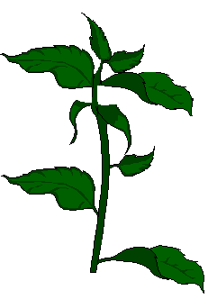
Repellant Silicone Adjuvants
Cause spray droplets to bounce off leaves so foliar injury is reduced and soil activity is increased.
References:
    Sprague, C. L., Penner, D., and Kells, J. J. 1999. Protection of corn from early postemergence application of isoxaflutole with metolachlor + benoxacor. Proc. Weed Sci. Soc. Am. 39: 137-138.
    Penner, D., Sprague, C. L., and Burrow, R. F. 2002. Compositions and methods of protecting cultivated plants from herbicidal injury. U.S. Patent 010096.
Notes:
If you do not like stickers – here is a patent that repels the application from leaf surfaces.
It is the opposite of what we usually try to do with silicones and is not such an outrageous idea.
Its for soil applied herbicides that you do not want to be lost on the leaves.
They are called “Repellant Adjuvants”.
2002 Application 10,096 Repellant adjuvant like Ethyl trimethoxy silane And a Coupling agent N-(2-aminoethyl)-3-aminopropyltriethgoxysilane or sodium methyl siliconate.

Slide 24
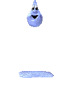
Non-Spreading Silicone Adjuvants
Use of non-spreading silicone surfactants to quickly make pesticides rainfast, by quick absorption with low surface tension and fast drying spray deposits.
    Reference:
    Humble, G. D., Kennedy, M. W., and Simpelkamp, J. R. 2003. Use of non-spreading silicone surfactants in agrochemical compositions. U.S. Patent Application 2003104944.
Notes:
There are other non-spreading silicone adjuvant patents to make pesticides rainfast.

Slide 25
High Load COC or
Hybrid Surfactant – COC
Some new crop oil concentrates or have 35 to 50% surfactant instead of the traditional 10 to 20%.
Oil can be petroleum or modified seed oils (MSO).
Often called 60/40 COC and used at intermediate concentrations between surfactants and COC.
Notes:
Another example of combining adjuvant types are the new high load surfactant oil concentrates.
(read from slide)
These products are hybrids of surfactant and traditional COC (crop oil concentrate) technology.
This hybrid nature and lack of an official definition creates a problem on how to prescribe on officially approved pesticide labels.

Slide 26



From Liquid to Solid
Many ways to make liquids into dry products such as silica, silicate clays, urea clathrates, calicium carbonate, starch, lignosulfonates, “dry bonding” to fertilizers, etc;
References:
    Helena Product Manual, see DC products.
    Hartmann, F. and J. M. Green. 2001. Low dose urea-surfactant adjuvant for sulfonylurea herbicides. Pesticide Formulations and Application Systems, 21st Vol., ASTM STP 1414, J. C. Mueninghoff, A. K. Viets, and R. A. Downer, Eds., American Society for Testing Materials, West Conshohocken, PA, pp. 236-245.
Notes:
We often want to change the physical forms of our products.
There are several ways to make good liquid adjuvants into dry products
such as silica, clays, urea clathrates, lignosulfonates, etc;

Slide 27
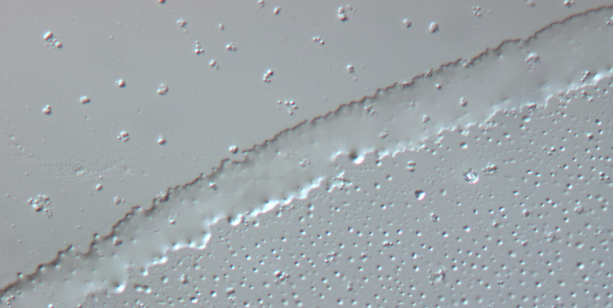
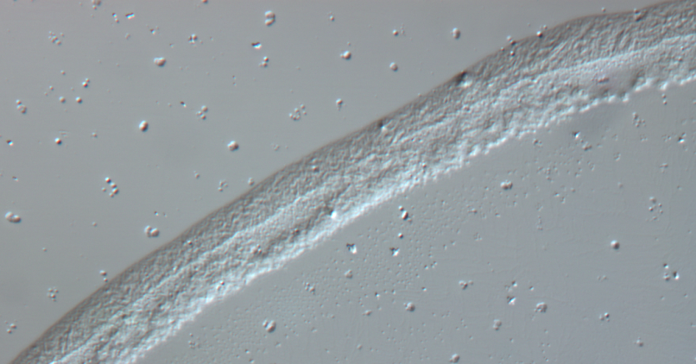
From Liquid to Solid and the Reverse!
Propoxylating the EO Chain (alkoxylation) can make a hard wax into a liquid and improve leaf contact and increase activity.
References:
    Huntsman Product Manual, Surfonic® L68-28X.
    Green, J. M. and Hale, T. 2003. Effect of adjuvant type on the control of yellow foxtail (Setaria glauca) with nicosulfuron. Proc. Weed Sci. Soc. Am. 43: 161.
Notes:
Similarly, there are ways to make good waxy or solid adjuvants into liquid products
such as adding propylene oxide to the ethylene oxide chain. We are seeing advantages with
the above product from Huntsman.
It is logical that for maximum uptake, the spray deposit to be liquid on the leaf surface so the spray deposits makes better contact with the leaf.

