Slide 1
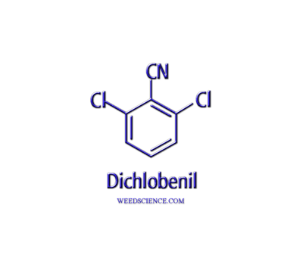
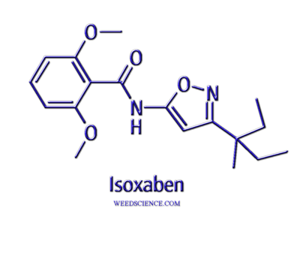
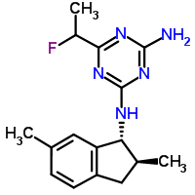
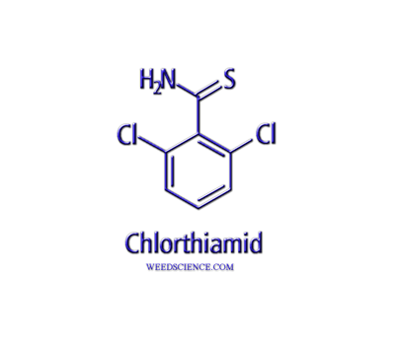
Cellulose Biosynthesis Inhibitors
indaziflam

Slide 2
Dichlobenil
discovered in 1950’s
applied preemergence; activity on annual grasses, nutsedge and many broadleaf weeds
strong inhibitor of shoot and root growth, inhibits germination
rapid translocation when root absorbed
most plants unable to metabolize, (differential uptake, placement)
rapidly evaporates from soil surface, incorporation with mechanical implements or irrigation water, unless applied during winter months
tightly adsorbed by soil OM, and relatively resistant to leaching
soil persistence is two to six months, depending on rate
soil micro-organisms responsible for gradual breakdown

Slide 3
Isoxaben
used preplant incorporated and preemergence
registered in established turf, ornamentals, nursery stock, non-bearing fruits, nut and vine crops, Christmas trees, and noncropland areas
primarily active on broadleaf weeds, highly effective on seedling or germinating weeds
rapidly absorbed by plant roots and translocated to leaves
limited foliar uptake with less than 3% absorption after 72 hours
tolerance appears to be differential absorption
strongly bound to soil colloids with slight leaching capabilities
moderate to long residual, control up to 5-6 months
primary means of degradation is through microbial decomposition

Slide 4
Indaziflam
preemergence
registered in established turf, ornamentals, nursery stock, non-bearing fruits, nut and vine crops, Christmas trees, and noncropland areas
primarily active on broadleaf weeds and grasses, highly effective on seedling or germinating weeds
rapidly absorbed by plant roots and translocated to leaves, limited foliar uptake < 3% absorption after 72 hours
foliar applications to sensitive plants will show growth inhibition, stem and petiole cracking and swelling, and malformed leaf hairs
tolerance appears to be differential absorption
strongly bound to soil colloids with slight leaching capabilities
moderate to long residual, control up to 9-12 months
primary means of degradation is through microbial decomposition

Slide 5
Simplified Version - 1999

Slide 6
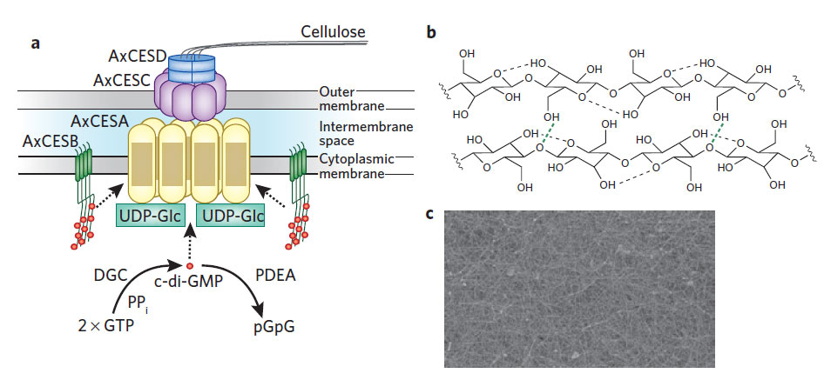
Cellulose Biosynthesis
Glycobiology: Cellulose squeezes through
Anne Endler, Clara Sánchez-Rodríguez & Staffan Persson
Nature Chemical Biology 6, 883–884 (2010) doi:10.1038/nchembio.480
Glycobiology: Cellulose squeezes through. 2010. Anne Endler, Clara Sánchez-Rodríguez & Staffan Persson
Nature Chemical Biology 6, 883–884.

Slide 7
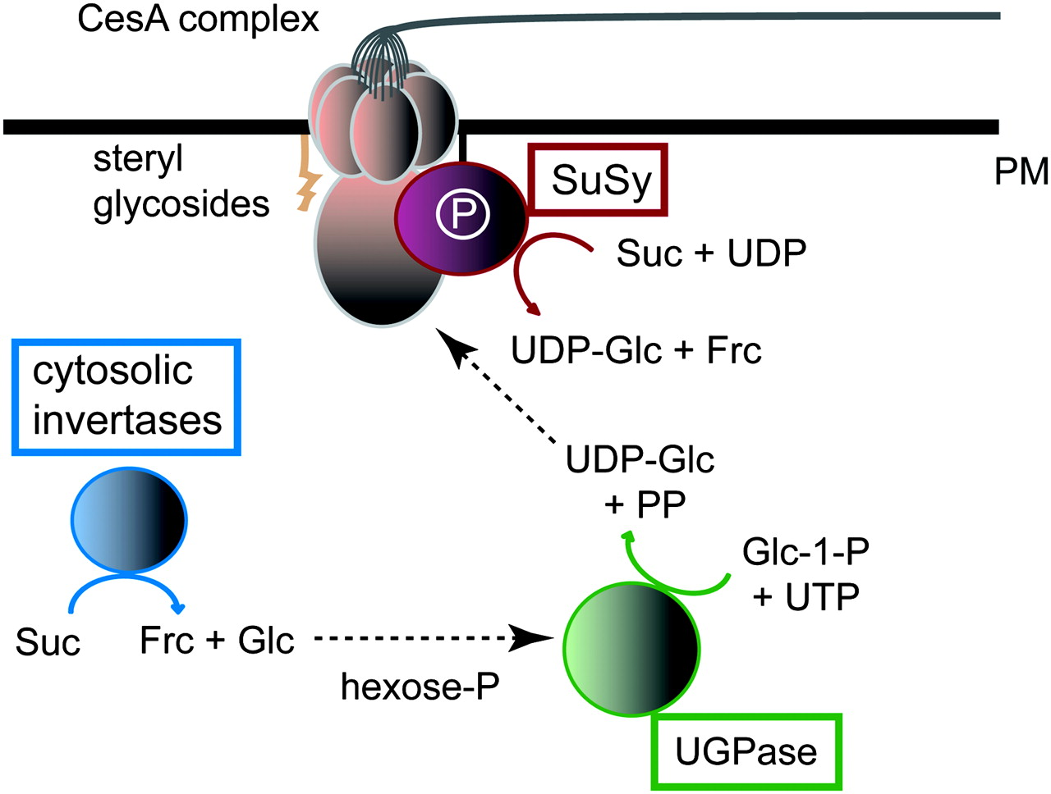
Carbon Supply for Cellulose Synthesis at the Plasma Membrane (PM).CesA complexes, here depicted as a rosette-like structure and a large cytoplasmatic domain, use UDP-Glc as the activated sugar donor for the β-1,4 glucan chain polymerization.
Endler A , and Persson S Mol. Plant 2011;4:199-211
© The Author 2011. Published by the Molecular Plant Shanghai Editorial Office in association with Oxford University Press on behalf of CSPP and IPPE, SIBS, CAS.

Slide 8
