Slide 1
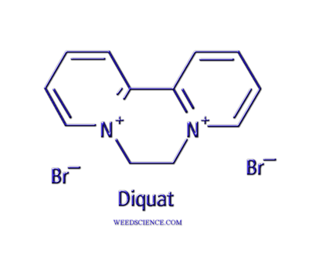
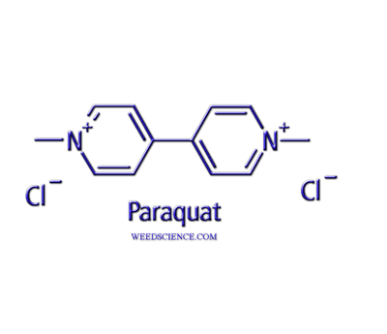
Electron Diverters
Bipyridilliums

Slide 2
History
Both compounds discovered in 1950’s
Originally patented as growth regulators
Later registrations as herbicides – early 1960’s

Slide 3
Electron Diverters
Foliar applied, contact activity only
No translocation, although can move in xylem under certain conditions
Non-selective – destroys green tissue

Slide 4
Paraquat
primarily used in cropping systems for total vegetation control prior to planting (burndown)
directed spray in certain crops – corn, sorghum, soybean, fruit and nuts
harvest aid and desiccant – soybean, cotton
emerged weed control in peanut
also known as methyl viologen

Slide 5
Diquat
harvest aid and desiccant – potato
aquatic weed control – emerged and submersed species
control/prevent sugarcane flowering
weed control in dormant pastures and ornamentals

Slide 6
Bipyridilliums
Both molecules highly water soluble – salts
Irreversibly bound to soil particles
Plants cannot uptake
Unavailable to microbes
No leaching (immobile)
Estimated half life in soil – 1000 days
In water half life ~ days

Slide 7
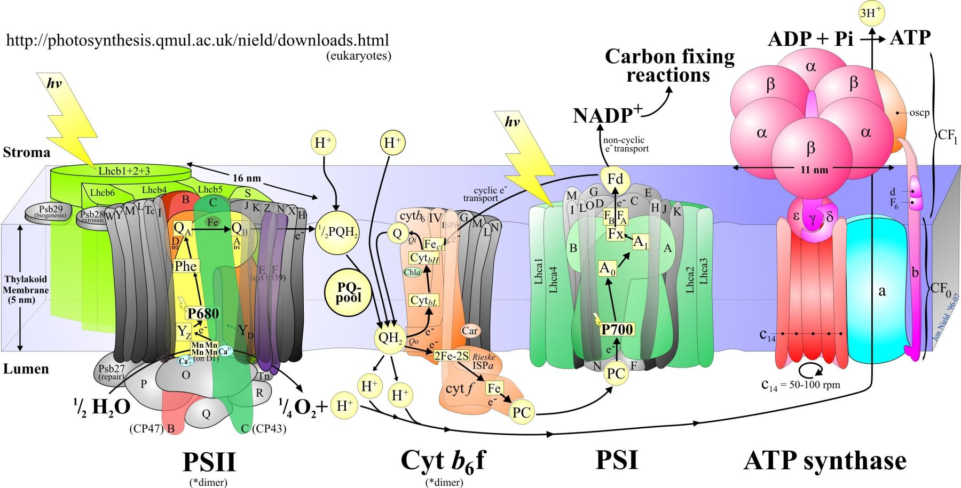

Slide 11
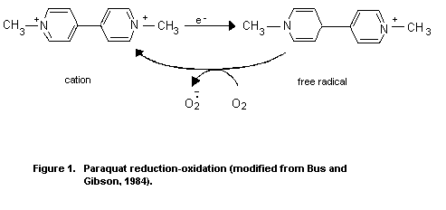

Slide 14
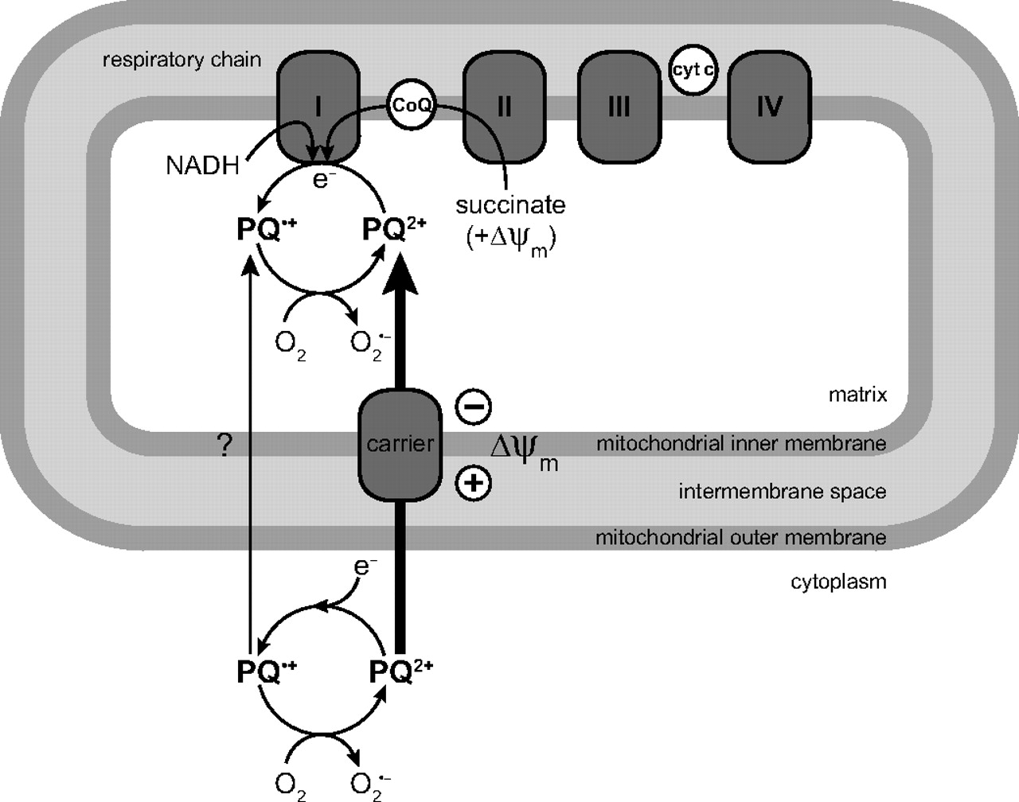
High mammalian toxicity – several deaths attributed to paraquat

Slide 15
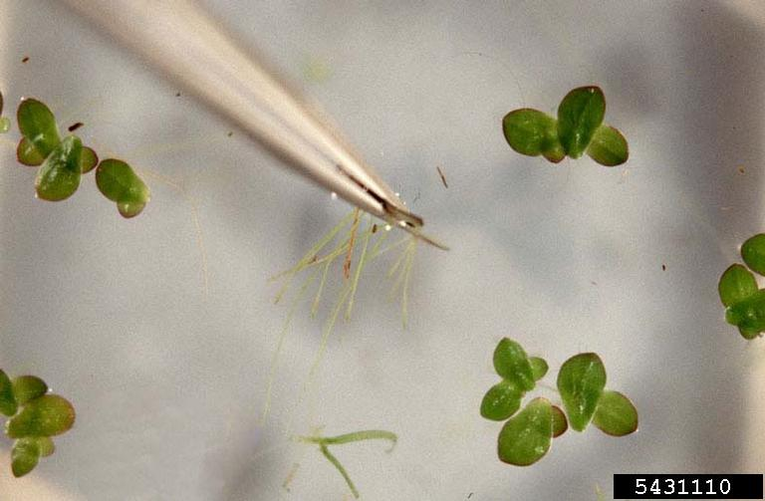
Resistance
Several species – 28 worldwide
horseweed, fleabane, grasses, nightshade, duckweed
Mechanisms not well understood
Reduced uptake at plasma membrane
Sequestration into vacuole
Radical detoxification

