Slide 1
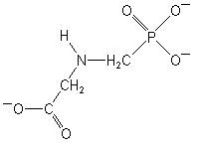
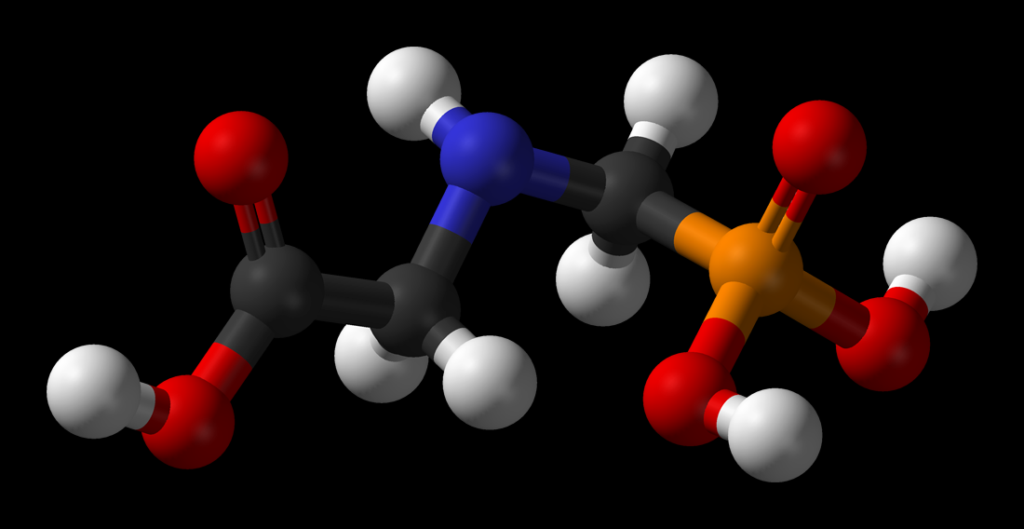
Glyphosate

Slide 2
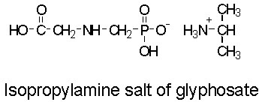
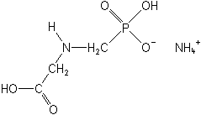
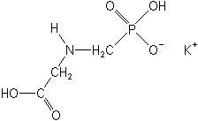
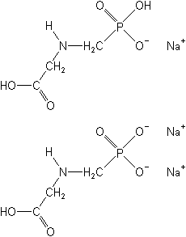
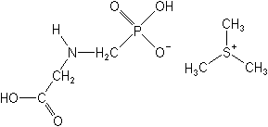
Glyphosate
Ammonium salt
Potassium salt
Trimethysulfonium (trimesium) salt
Sequisodium salt

Slide 3
Glyphosate
First patented in 1964 by Stauffer Chemical as a chelating agent
First herbicide activity discovered in 1971
Registered in U.S. by Monsanto
Registered as trimesium salt (sulfosate) in Europe by ICI in 1989
Monsanto also patented a unique tallow-amine surfactant (Frigate) in several formulations (Roundup)

Slide 4
Glyphosate
Used extensively for several years for total vegetation control – non selective postemergence control
General weed control under trade name Roundup
Forestry under trade name Accord
Aquatics under trade name Rodeo
Sugarcane ripening under trade name Pollado
Peanut yield enhancer under trade name Quotamaker (only in 1990)

Slide 5
Glyphosate
1) Prior to planting annual crops
2) Prior to planting minimum tillage corn, soybeans, sorghum, etc.
3) Post directed applications in fruit and nuts, woody ornamentals
4) Spot treatments in pastures
5) Renovation of lawns and pastures
6) Christmas trees and other conifers
7) Noncropland, industrial sites, rights of way
8) Growth regulator for perennial grasses
9) Pre-harvest weed control in soybeans, cotton
10) Forestry – site prep and pine release
11) Aquatic weed control – emergent species, ditchbanks, etc.
12) Invasive species management
13) Homeowner weed control

Slide 6
Glyphosate
Non-selective
Foliar activity only
Leaves and green stems, limited if any, uptake from bark or woody tissues
Extensive translocation to regions of active growth, follows sucrose movement
Highly stable and not readily metabolized
No activity in soil or water

Slide 7
Function of EPSP synthase
444 amino acids, 72 transit peptides = 516 total
Nuclear encoded – transported to chloroplast
Function of EPSP synthase
Combines shikimate-3-phosphate with phosphoenolpyruvate (PEP) to form 5-enolpyruvylshikimate-3-phosphate (EPSP)

Slide 8
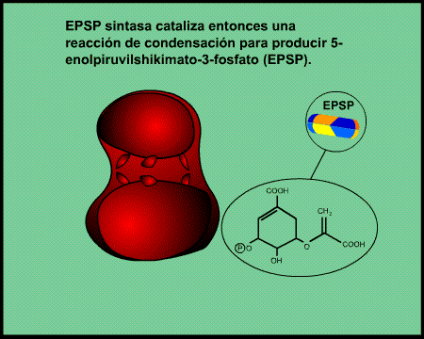
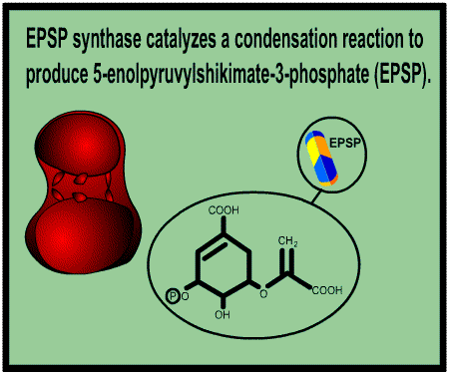

Slide 9
Shikimic Acid Pathway
Aromatic amino acid synthesis
Tryptophan
Phenylalanine
Tyrosine
Alkaloids, flavanoids
Auxin regulatory compounds
Phytoalexins
Major carbon sink – 20 to 40%

Slide 10
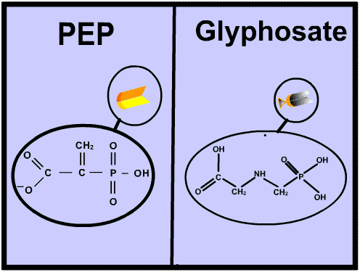
Glyphosate at the Active Site
Once shikimate-3-P is in the active site, glyphosate competes with PEP for binding within the pocket
Once bound it inactivates the enzyme
2,300X the dissassociation rate of PEP

Slide 11
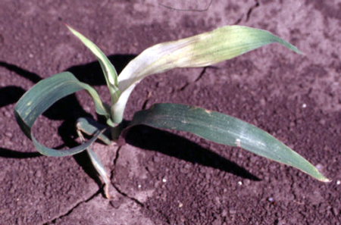
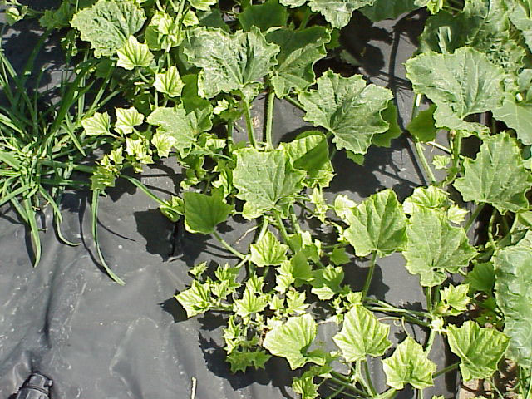
Glyphosate Symptomology
Yellowing, chlorosis, necrosis
Can be almost white
Apical meristems, new growth
Takes several days for symptoms to be noticed, better growth conditions result in quicker control - Why?

Slide 12
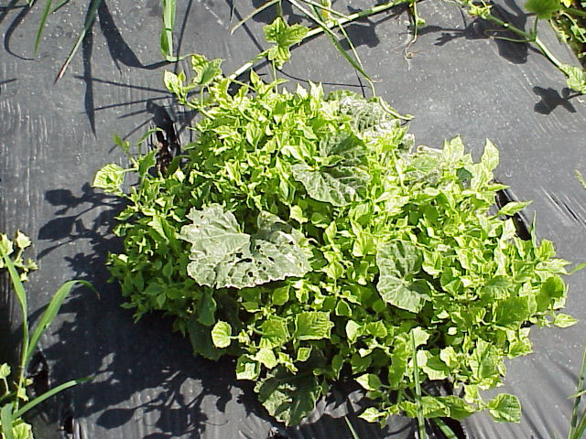
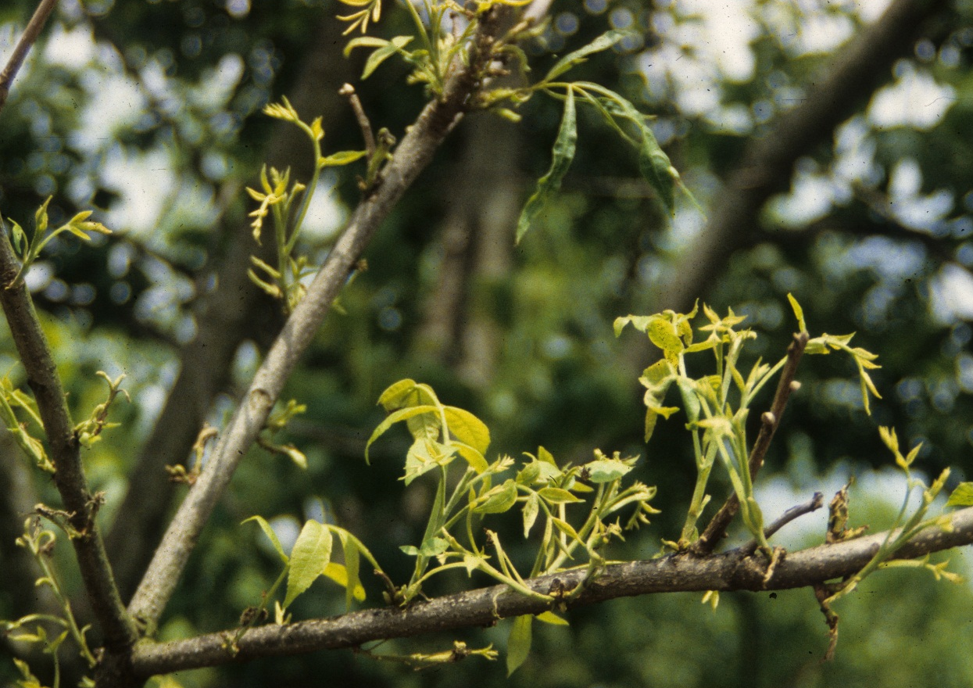
Glyphosate Symptomology
Bud fasciation - witches broom effect
Multiple bud formation with highly compacted internodes
Bud sprouting, loss of flower formation in perennial trees and shrubs

Slide 13
Engineering for Resistance
Callus cultures – expose cells to increasing levels of glyphosate, select for a mutant
Resulted in cells with multiple copies of the gene – more enzyme (still not enough)
Mutants from petunia – didn’t bind glyphosate, but low affinity for PEP
Metabolism – rare in plants, occurs in bacteria

Slide 14
Genetic - Metabolism
Genes for metabolism include (glyphosate oxidoreductase – GOX gene) inserted to enhance degradation of glyphosate in plants
Glyphosate -----> AMPA
AMPA is phytotoxic in certain plants - cotton
another metabolism gene (GAT) can be used to acetylate AMPA
AMPA--------------> n-acetyl AMPA
**(not all glyphosate tolerant crops have these genes)

Slide 15
Genetic Approach
Gene that codes for ‘wild type’ of EPSPS from Agrobacterium spp. strain CP4
Homology with plants is <50%, also change in number of amino acid residues
Inserted into genome so plant produces both the sensitive and wild type genes

Slide 17
DNA inserted into RR Soybeans via a vector plasmid
This is the insensitive gene that confers glyphosate resistance. It came from bacteria.
This is the promoter that overexpresses the CP4 gene. It came from cauliflower mosaic virus.
CP4 EPSPS
CTP
E35S promoter
Plant DNA
Plant DNA
3’
5’
This is the “chloroplast transit peptide”. This gets the gene into the chloroplast so it can operate. It came from petunia.
Notes:
The resistant form of the target enzyme (EPSP synthase) for glyphosate resistance is known as CP4. As we mentioned earlier, the resistant EPSP gene is from Agrobacterium while other parts of the gene construct (the promoter, chloroplast transit peptide, and terminating sequence) are from several other organisms.

Slide 18
Roundup Ready Crops
RR Soybean (1996) RR Corn 1 (1998)
RR Cotton (1997) RR Canola (2000)
RR Sugar beet (2009,2012) Potatoes* (2000-2001)
RR Corn 2 (2004) RR Alfalfa (2005-07??)
RR Flex (2006)
Developed but never made it to market
RR Lettuce
RR Bentgrass
RR Rice
RR Wheat
*McDonald’s refused to buy , so that killed the market
Notes:
This is a list of glyphosate resistant crops with the date of the their approval and ones yet to be approved and ones that may never be marketed. Potato was pulled from the market because McDonalds would not buy GE potato for their French fries and wheat was shelved because growers were worried about European export markets. Bentgrass is questionable because of the data I showed in a previous slide concerning pollen movement over long distances.

Slide 19
Ok, sure…….
“Information obtained in the development of glyphosate-resistant crops suggests that target-site alterations that
decrease the herbicidal activity of glyphosate also may lead to reduced survival of a weed. In addition, the complex manipulations that were required for the development of glyphosate-resistant crops are unlikely to be duplicated in nature to evolve glyphosate-resistant weeds.”

Slide 20
Resistance is Growing….
32 species to date
reduced translocation, horseweed, Lolium rigidum
translocation out of target site, goosegrass
mutation of target site (Pro106), goosegrass and Lolium
overexpression of DAHP
gene amplification of EPSPS - Palmer amaranth

