Slide 1
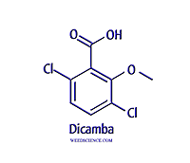
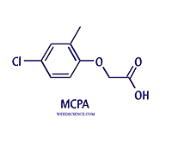
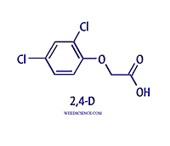
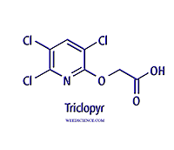
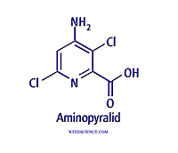
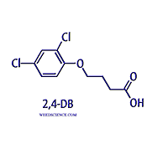
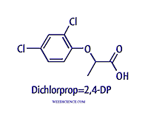
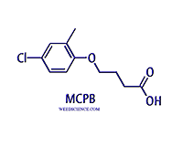
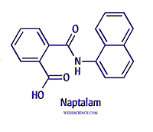
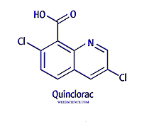
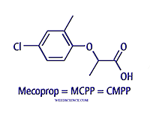
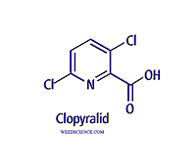
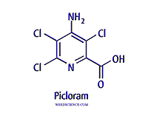
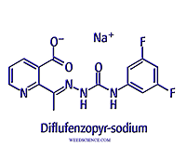
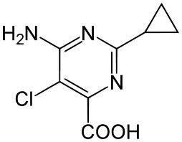
Growth Regulators

Slide 2
Growth Regulators
Two primary groupings - auxin mimics and auxin transport disruptors
Mimics – phenoxys, picolinic acids, benzoic acids, pyrimidine carboxylic acid
Transport disruptors - quinclorac, naptalam, and diflufenzopyr

Slide 3
History
Simultaneous discoveries by plant physiologists in U.S. in 1942
Trying to study ways to increase crop yield through hormone manipulation
After World War II, several companies began manufacture and marketing
DuPont, Dow, Monsanto, Union Carbide
Beginning of herbicides and weed science as a discipline

Slide 4
Formulations of 2,4-D
28 different formulations since discovery
Ester formulations have greater activity than salts
Short chain esters highly prone to volatilization and no longer registered
Currently 9 supported by EPA
parent acid
sodium, diethanolamine, dimethylamine, isopropylamine, and tri-isopropanolamine salts
2-butoxyethyl, 2-ethylhexyl, and isopropyl esters
Dicamba only a salt, picolinic acids both salts and esters

Slide 5
The monocot vs. dicot issue??
For many years phenoxys were thought to be active on dicots and not monocots
Labeled for use in grass crops such as wheat, corn, sorghum, rice, pastures
Active only on broadleaves, which were mostly dicots
Separation still exists today
Broadleaves vs. grasses, or even weeds vs. grasses

Slide 6
The 2,4,5-T Story
2,4,5-T developed in late 1950’s, early 60’s
Tremendous soil and foliar activity, considered the standard for woody brush control (Silvex)
Also principle active in Agent Orange
Agent Orange used for wide-spread jungle defoliation in Vietnam war
Actually combination of 2,4-D and 2,4,5-T
High levels of dioxin as a contaminant in Agent Orange
EPA cancelled registration in early 1980’s

Slide 7
Mode of Action
Foliar and root uptake, extensive translocation in phloem to meristems (weak acids)
Rapid twisting, stem elongation, leaf malformation that includes cupping, strapping, curling
Floral abortion, mis-shapenned fruit, puckering
Stem bending in grasses, brace root malformation
Eventual meristem necrosis followed by plant death

Slide 8
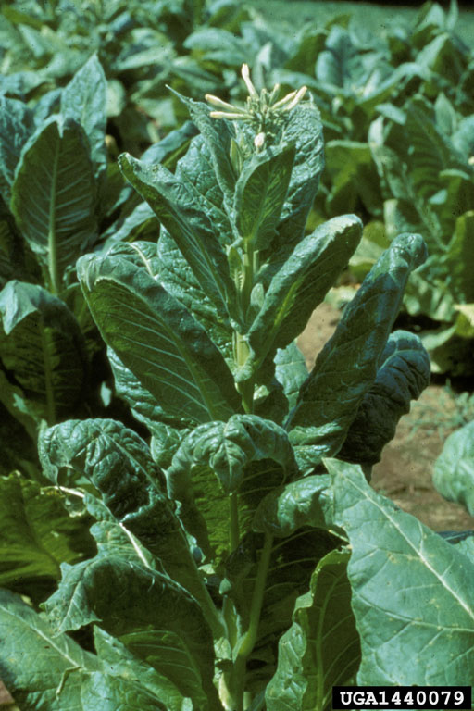
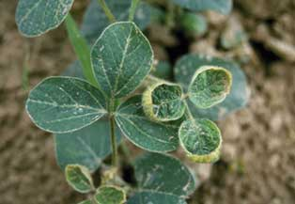
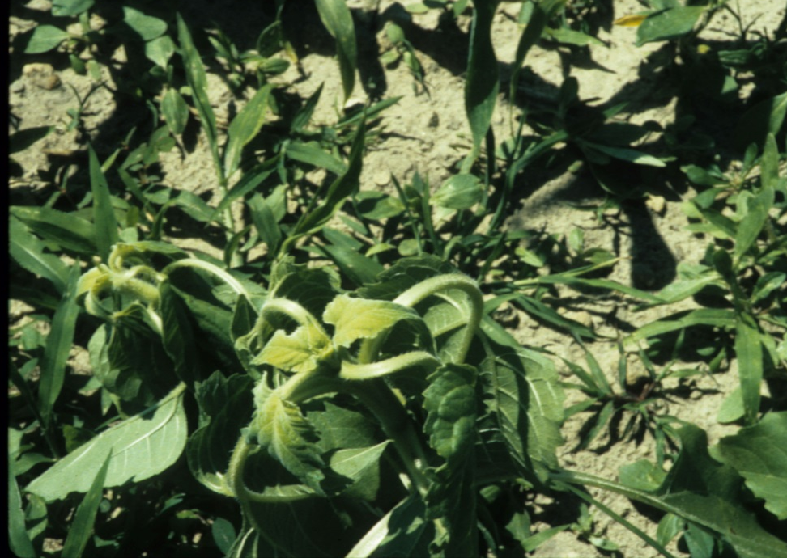
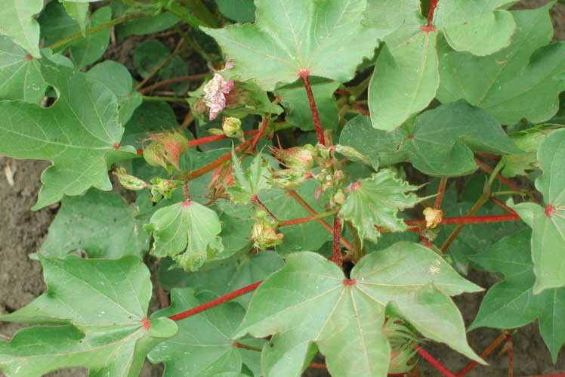
Symptomology

Slide 9
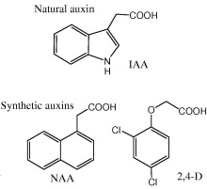
Mechanism of Action - Mimics
Perceived by plant as auxin?
Activate membrane –bound ATPase pump, acidified cell walls and caused elongation
Increase in RNA polymerase – increased cell division at uncontrolled rate
Increased ethylene generation

Slide 10
Mechanism of Action - Mimics
Appears to be linked to influx and efflux carrier proteins in the plasma membrane
2,4-D is readily taken up by influx carriers
Not exported by efflux carriers
More importantly, 2,4-D is not metabolized nor diffused to a great extent
Stimulation of ethylene also observed

Slide 11
Quinclorac
Although auxin mimic, appears to cause effects through ethylene
Stimulates 1-aminocyclopropane-1-carboxylic acid synthase
S-adenosylmethionine converted to 1-aminocyclopropane-1-carboxylic acid ethylene but also hydrogen cyanide
Ethylene stimulates ABA, inducing stomatal closure, photosynthesis ceases, increase in oxidative stress

Slide 12
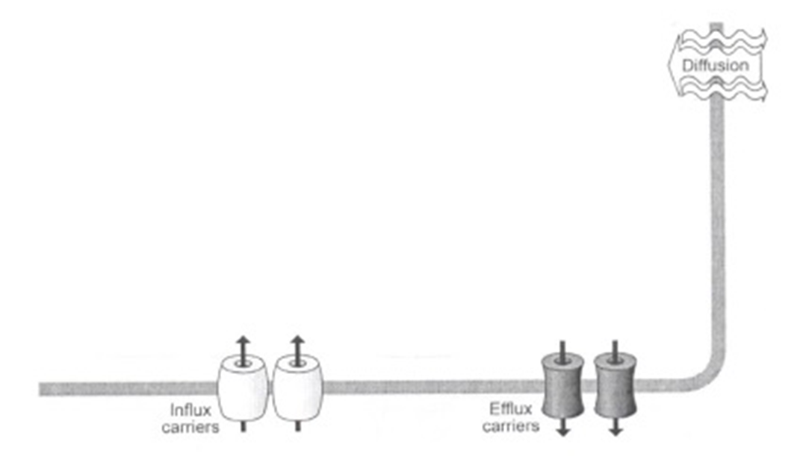
Mechanism of Action - Transport
Naptalam and diflufenzopyr have been shown and used to inhibit efflux carriers, preventing normal auxin distribution in plant tissues
Diflufenzopyr is used in conjunction with dicamba (auxin mimic)

Slide 13
Time for Thoughts……..
So is this the complete story of how these herbicides work
????

Slide 14
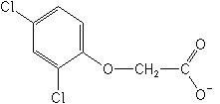
Selectivity
Almost exclusively metabolism for phenoxys and dicamba
Decarboxylation, dechlorination
Conjugation through glucose or amino acids
2,4-DB and MCPB – tolerance to legumes
β-oxidation of two carbon sequences from the side chain leads to formation of 2,4-D, which is the active form
Low β-oxidase activity in legumes, some research suggests lengthening of side chain as another tolerance mechanism
activation
2,4-DB
2,4-D

Slide 15
Selectivity
Picolinic acids – mostly conjugated with sugars and many are sequestered in vacuole
This can result in persistence, carryover and off target movement
First noticed with picloram in tobacco and a mule

Slide 16
Resistance
Relatively rare but has occurred in wild mustard, yellow starthistle, common chickweed
Not fully understood, but appears to be altered receptor

Slide 17
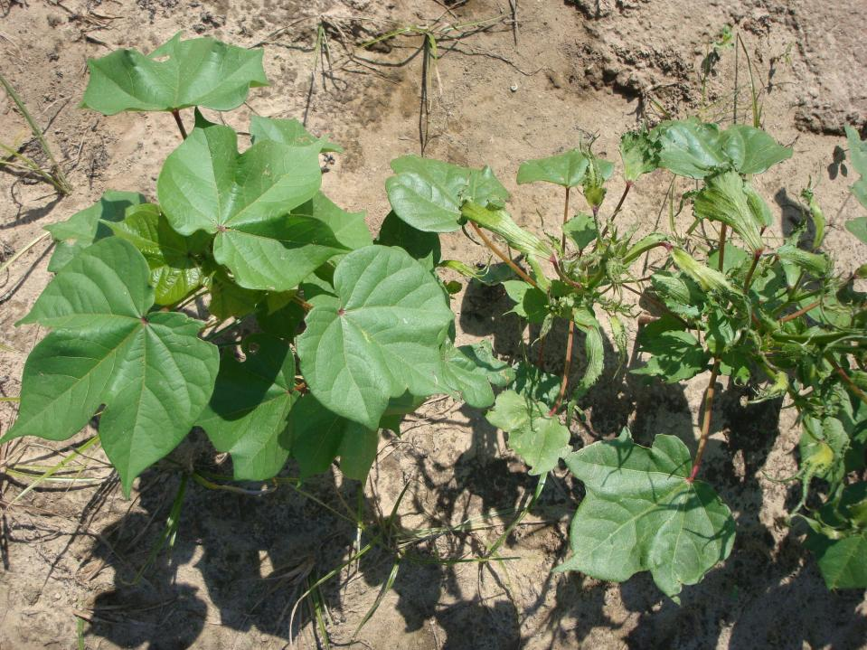
Photo: W. Vencill – Univ. of Georgia
2,4-D resistant cotton
2,4-D sensitive cotton
Notes:
Comparison of 2,4-D resistant cotton to conventional cotton.
17

Slide 18
Dicamba resistant soybean and cotton
dicamba mono-oxygenase (DMO) cloned from a soil bacterium (Stenotrophomonas maltophilla)
DMO enzyme encodes a Rieske nonheme monooxygenase
metabolizes dicamba to 3,6-dichlorosalicylic acid (DCSA)
dicamba O-demethylase complex (monooxygenase, reductase, ferredoxin)
expressed in cell nucleus & chloroplasts where the monooxygenase would have a source of electrons

Slide 19
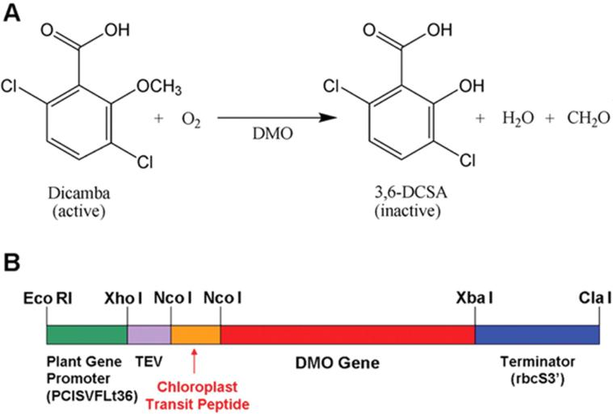
Fig. 1. Dicamba inactivation.
M R Behrens et al. Science 2007;316:1185-1188
Notes:
Dicamba inactivation. (A) Conversion of dicamba to DCSA by DMO. (B) Genetically engineered version of the DMO gene for expression in higher plants, using the FLt36 promoter from peanut chlorotic streak virus, a translational enhancer from the tobacco etch virus (TEV), a chloroplast transit peptide–coding region from the pea Rubisco small subunit gene for chloroplast localization of DMO, and a terminator region from the pea Rubisco small subunit gene (rbcS3′).

Slide 20
2,4-D Tolerant Cotton and Soybeans
aryloxyalkanoate dioxygenase provides resistance to certain auxins
gene was isolated from Delftia acidovorans (trait, DHT2)
codes for a 2-ketoglutarate dependent dioxygenase that inactivates phenoxyacetate auxins
second gene (aad-1) isolated from Sphingomonas herbicideovarans
inactivates auxins and ACCase-inhibiting herbicides

Slide 21
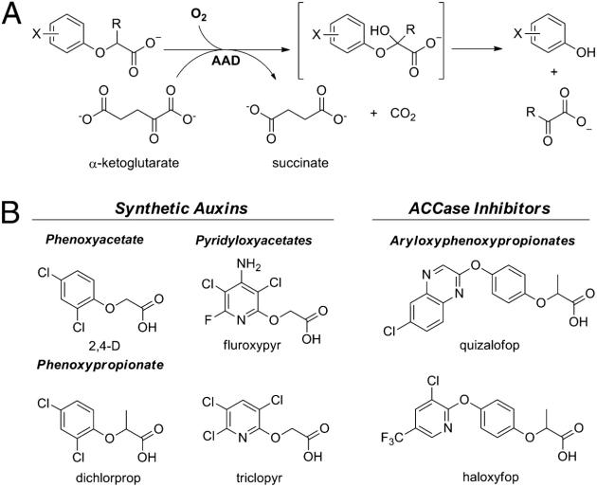
Wright T R et al. PNAS 2010;107:20240-20245
Notes:
(A) General reaction catalyzed by AAD enzyme. (B) Aryloxyalkanoate herbicidal compounds that are substrates for AADs.

Slide 22
Mechanisms are quite different
DMO only provides resistance to dicamba
AAD-12 – resistance to anything with a O-C-COOH group on the end.
These technologies will be stacked with other technologies.
Roundup Ready + Liberty Link + 2 or 3 Bt’s…

