Slide 1
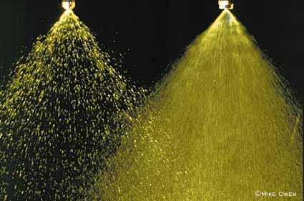
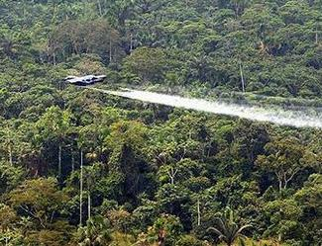
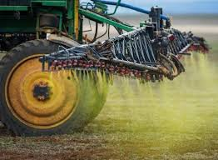
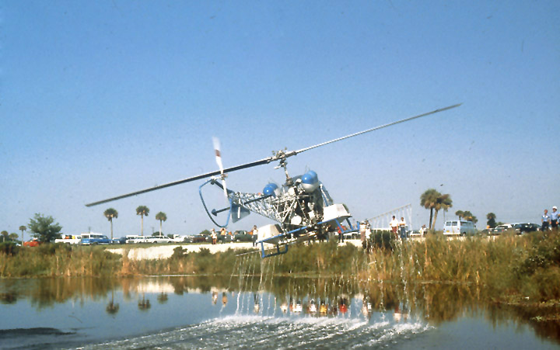
Reaching the Target

Slide 2
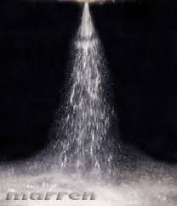
Droplet Size
Droplet sizes range from 50-400 um, physical characteristics (strive ~ 200 uM)
larger droplets fall due to gravity, more likely to stick to upper leaves
smaller droplets influenced by air currents and more likely to penetrate canopy and be retained on vertical surfaces
controlled droplet applicators – minimize fine particles, optimize size for particular targets
ion charge droplets – place positive charge
on droplet, attract to plant or soil

Slide 3
Fate of the Droplet
Does it stay or does it bounce?
surface tension of droplet - high tension, high tendency to recoil
nature of the leaf surface - irregular retains more spray droplets
larger droplets may shatter, producing fines
*Surfactants act to reduce surface tension, increase spread of droplet

Slide 4
Chemical Characteristics of the Droplet
Concentration of herbicide per droplet may influence activity
increased uptake due to higher concentration gradient
decreased uptake due to higher localized phytotoxicity

Slide 5
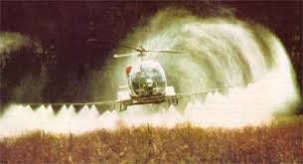
DRIFT!!!!
1. droplet drift
a) sprayer considerations - nozzle type, size, pressure
b) evaporation of droplet, transit time (nozzle height)
c) wind speed, turbulance
d) canopy characteristics - boundary layer
2. vapor drift
a) volatility (vapor pressure, solubility)
b) soil - adsorption, moisture status (more volatility from moist soils)
c) air movement
d) surface temperature - irradiant energy

Slide 6
Herbicide Soil/Plant Interactions
Herbicide Availability in Soil
1. influenced by adsorption to soil particles (this is a reversible process);
these include organic matter, clay, mineral surfaces, oxides
2. in general, the more soil surface areas, the greater the adsorption
3. adsorption is generally weak bonding (hydrogen/van der Waals forces)
a) between herbicide and soil particle
b) between herbicide and water adsorbed on soil particles
4. ionic bonding can occur (ionic herbicides or weak acids or bases)
Herbicide Adsorption - Freundlich Equation x = KCn
x = amount of herbicide adsorbed
C = equilibrium conc. herbicide in solution (ug/ml)
K, n = constants for a particular soil
Kd = x/C - distribution coefficient of herbicide adsorbed to herbicide in soil water
K_{f} = distribution coefficient if the adsorption is not linear
5. amount of herbicide adsorbed influenced by:
a) nature of soil and mineral components (pH is a critical factor)
b) nature of the herbicide
c) soil water status

Slide 7
Fate of herbicides in the soil
Leach – high rainfall, porous soils
Surface runoff – clay soils with crusting characteristics
Lateral movement – depends on soil layering, hardpan or clay subsoil
Capillary action – upward movement, rare and hard to document (similar to salt)
Adsorption/Desorption
Degradation – various ways

Slide 8
Soil Water and Herbicide Availability
Properties of Soil Water
Herbicide Transport in Soil
Plant Processes
Herbicide absorption
Rate of water movement
Mass flow in soil water
Soil Water Content
Herbicide translocation & phytotoxicity
Herbicide conc. in soil water
Molecular Diffusion
Soil water tension
Plant Transpiration
*high concentration of herbicide in the soil water solution does not correlate directly with increased plant uptake

Slide 9
Degradation of Herbicides in Soil
chemical decomposition - highly dependent on soil pH
microbial decomposition - those conditions that favor microbial growth favor herbicide breakdown (high moisture, high temperatures)
more times herbicide is used, shorter the lag phase of microbial breakdown
observed for phenoxys and thiocarbamates

Slide 10
Herbicide soil uptake by plants
tissue types - any tissue in the soil that is contacted by the herbicide (water sol.) generally roots but can be shoots or seed directly
potential for continuous uptake under adequate moisture regimes (unlike foliar)
most uptake occurs in the apical region - before Casparian strip, water uptake
however, flow through endodermal cells not limiting factor to uptake
driven by chemistry –
symplastic herbicides go through cells using plasmodesmata
apoplastic herbicides go through cell wall and intercellular spaces
transmembrane goes right across each cell

Slide 11
Root Concentration Factor
Herbicide conc in root tissue Herbicide conc in solution
EXAMPLES -
1.0 = herb in tissue is equal to solution conc. ~ equilibrium
< 1.0 = incomplete permeation of tissue
initial absorption and RCF correlated with lipophilicity
polar compounds RCF ~ 0.6 - 1.0
lipophilic compounds RCF ~ >1.0
weak acids, RCF increases as pH decreases

Slide 12
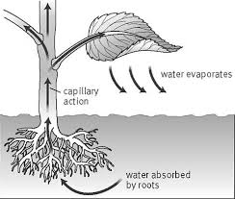
Transpiration Effect
root herbicide absorption independent of transpiration
more dependent on factors influencing herbicide partitioning into root tissue

Slide 13
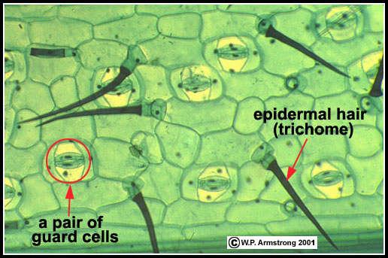
Foliar Herbicide Uptake
Influenced by:
chemical and physical nature of the cuticle
properties of the herbicide and formulation and/or surfactants
environment of leaf cuticle development
environment at time of absorption

Slide 14
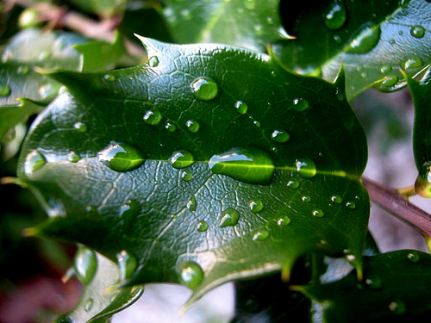
Cuticle
thin, multi-component layer covering leaf surfaces
prevents water loss; barrier to diseases, insects; shield UV-light
components of the cuticle
epicuticular waxes - varying, long-chain aliphatic hydrocarbons (C₂₀ to C₃₇); extruded in various ways to form plates, crystals, etc.
cutin framework - C₁₆ to C₁₈ hydroxycarboxylic acids (single, cross-linked); some frameworks also contain suberin
cuticular waxes - embedded C₁₆ to C₁₈ fatty acids
pectin and cellulose carbohydrate polymers - fibrillae that extend from cell
outer surface highly lipophillic and inner hydrophillic
some evidence indicates polar, lipophillic channels thru the cuticle
at physiological pH - cuticle is negatively charged with exchanges sites Ca++

Slide 16
Movement across the cuticle
dependent on three factors
partitioning into the cuticular membrane
diffusion across the cuticular membrane
partitioning into apoplasm
passive diffusion process - concentration gradient
uptake thru stomates - possibly under some conditions, not a major contributor
factors influencing absorption/movement
high temperature - less consistent than relative humidity effects
sometimes no effect, increase membrane fluidity, increased metabolic activity, more removal
high relative humidity
herbicide droplet retains more water, less likely to crystalize, hydrophillic pores swell, stomatal uptake?

Slide 17
Predicting Foliar Uptake
problems with using models to predict herbicide movement across cuticle
2 partitioning coefficients involved (into and out of cuticle)
hydration status of the cuticle
herbicide absorption a function of the contact area (highly variable)
studies indicate not correlated with wax removal or cuticle thickness
more correlated with soluble lipids, herbicide properties, overall cuticle membrane composition
some herbicide may be tied (bound) in cuticle

Slide 18
Herbicide Uptake into Plant Cells
cell wall - essentially a non-limiting factor
plasmalemma – cell membrane
lipophillic molecules, neutral in charge, penetrate more quickly and likely to be retained in membrane fraction, pH independent uptake
weak acids - solution of pH dependent, 10⁴ times more permeable in undissociated form, pKa a major factor in uptake, tendency to accumulate
active (carrier mediated transport) evidence points to 2,4-D (auxin mimic)
some herbicides may accumulate due to metabolism to polar products (glycosylation), or polar active compound

Slide 19
Herbicide Translocation
Short distance - cell to cell diffusion through plasmodesmata or free space; influenced by the ability to cross the plasmalemma - directly associated with physiochemical properties of the molecule
Xylem translocation
process - high water potential in soil, low in atmosphere
transpiration - influenced by stomatal aperture
herbicide xylem translocation correlates with transpiration rate
herbicides moves with water and accumulate in leaf tips, margins

Slide 20
Herbicide Translocation
Phloem translocation - sugars, amino acids, inorganic ions
osmotic pressure gradient (source:sink) tissues
direction of the flow dependent on carbohydrate pools
sucrose flows into apoplasm then into phloem cells or sucrose flows directly into phloem cells via plasmodesmata (carrier mediated process)
three active (energy) sites - loading, unloading, maintaining gradient
Herbicide-phloem movement
herbicide flow is never a complete match with sucrose
appears to be random diffusion with some in phloem, some in xylem
actually desirable because direct flow with sugar may actually miss some sites

Slide 22
Studying Translocation
extensive use of ¹⁴C
advantage - no cleanup, extraction, separation (more samples at once)
disadvantage - cannot discern between parent molecule and metabolites
considerations - what do you want to study?

Slide 23
Herbicide metabolism
Conversion
Hydrolysis
carboxylic acid ester
phosphate ester
amide
oxidation
oxygenation
hydroxylation - mixed function oxidases -S- + ½ O₂ –> -S(O)-
reduction - rare in plants
Conjugation
Glutathione - sulfur bonds to herbicide - transports to vacuole
Sugars - glucosides, N or O
Amino acids

