Slide 1
Miscellaneous Herbicides
“Unclassified
or
Unknown Mechanisms”

Slide 2
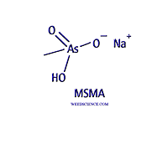
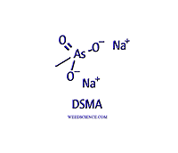
Organic Arsenicals
MSMA, DSMA (mono-sodium, disodium methyl arsenate); cacodylic acid
Uses are extremely limited, turfgrass, sod farm and highway registrations ended on December 31, 2013
However uses on cotton still pending
Post-emergence only, irreversible soil binding
Rapid foliar absorption, translocation in symplast
Not completely understood, appears to interfere with ATP production in TCA cycle, enzyme activity
Tolerance through conjugation to sugars, A-acids

Slide 3
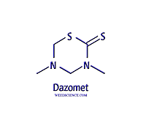
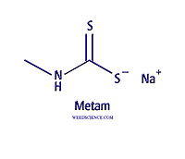
Dazomet, Metham
Both products used for soil fumigation
Activity on most biological organisms, uptake of a lethal concentration determines selectivity
Converted to several products upon activation with soil moisture– methylisothiocyanate (MITC)
Interfere with several basic cellular activities, metal co-factors, thio groups, enzyme activity
Degrades rapidly – crop planting after dissipation

Slide 4
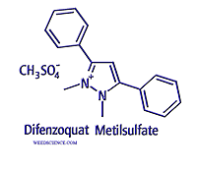
Difenzoquat
used postemergence for wild oat control in wheat and barley
also reported to possess fungicidal activity against powdery mildew
No soil activity, rapid degradation
rapidly absorbed by foliage and translocated to meristematic regions
exact mode of action not well understood
inhibits nucleic acid biosynthesis, photosynthesis, and ATP production
tolerance in cereals achieved through an altered site of action??
several resistant wild oat biotypes, mechanism unknown

Slide 5
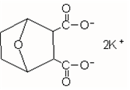
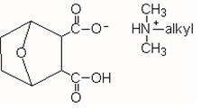
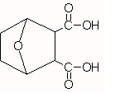
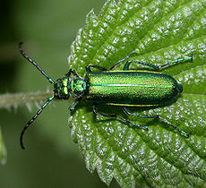
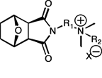
Endothall
General usage in aquatics for submersed weed control, some algae control
Rapid uptake and immediate activity on cell function – photosynthesis, respiration
Differential uptake is selectivity mechanism
One of the oldest herbicides and derived from natural product (cantharidin)
Highly toxic
Rapid degradation

Slide 6
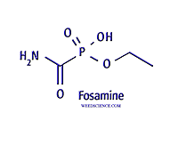
Fosamine
Labeled for use in non-crop areas, mainly conifer site preparation, but also powerline rights of way
Slowly absorbed by leaf tissue, translocation in apoplast and symplast
Symptoms not observed until following years growth
Differential uptake and translocation appears to be selectivity mechanisms

Slide 7
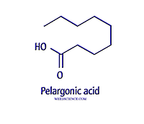
Pelargonic Acid (Scythe)
Labeled in wide range of areas, including homeowner market as organic herbicide
Contact activity, any green tissue is susceptible
No translocation, no soil activity
Interacts with cell membrane and leaf cuticle, essentially acts like a surfactant or soap to solubilize lipids and waxes

Slide 8
Sulfcarbamide (Enquik)
Alabama, Georgia, Idaho, Michigan, Oregon, and Washington
Certain vegetables, row-middles, wheat, fruits and grass seed
desiccant for dry beans, peas, lentils, peppermint, and potato
grape sucker control, peach flower thiner (Georgia – Wilthin)
non-selective, contact, rapidly absorbed by tissue, no translocation
rapidly broken down by plant enzymes into urea and sulfuric acid, in or near cell walls; sulfuric acid dissolves cell wall, breach of membrane integrity and the plant cell is destroyed
differential contact of spray (away from meristems)
immediately broken down in the soil into urea and sulfuric acid
bummer – registration cancelled August 2009, registrant did not file an acceptable declaration under Section 8.

Slide 9
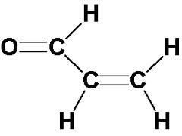
Acrolein
Registered since early 1950’s for total vegetation control in irrigation canals and ditches
Complete biocide at rates used (1-15 mg/L) injected into flowing water systems
Reacts with sulfhydryl groups, disrupts most if not all cellular functions
Highly toxic, corrosive, polymerize and expand
Human deaths and major fish kills reported
Rapidly degraded, within hours

Slide 10
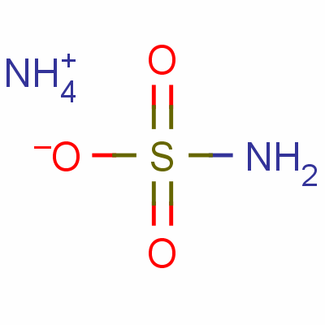
Ammonium Sulphamate
Been used since 1950’s in forestry
Hardwood, pines and brush control
Rates of 64 kg-ai/ha in 935 L water/ha
Good for cut stump treatments also
Not clear on mechanism of action
Corrosive, mixed as an oil:water emulsion
Ammate, Amicide – not sure how much still used, couldn’t find label

Slide 11
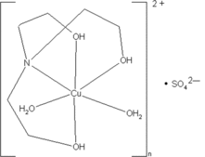
Copper (Chelates and SO4)
Used for many years as herbicide but also a fungicide – primarily for algae control
Chelated forms are complexes, while sulfate is copper and sulfate salt
Sulfate more toxic to fish and aquatic fauna
Mechanism of action unclear – inactivate enzymes, interfere with photosystem II

Slide 12
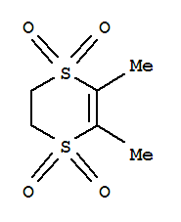
Dimethipin - Harvade
Used for years as a leaf desiccant for cotton, also directed weed control in cotton – non-selective
Rapidly absorbed by leaf and green stem tissue, not translocated
Immediate leaf necrosis
through stomatal stress
disintegration of epidermal cell walls

Slide 13
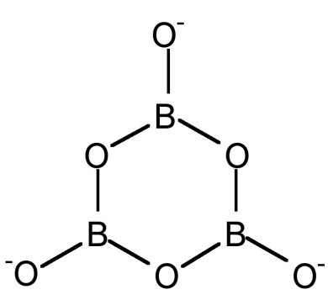
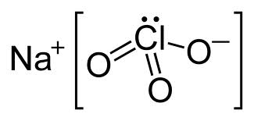
Metaborate & Sodium Chlorate
Both formulated as sodium salts and have foliar and soil activity
Sodium chlorate more active (~7 kg-ai/ha) while metaborate rates are 85-224 kg-ai/ha
Contact as a foliar, apoplastic movement from soil applications – rapid necrosis, desiccation
Unclear mechanism of action – interfere with calcium levels, enzyme activity, sulfonyl groups

