Slide 1
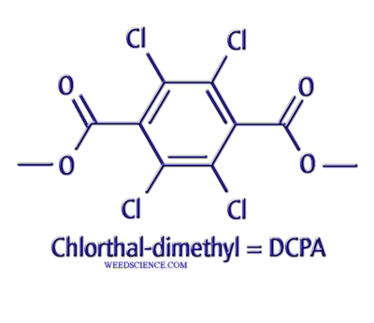
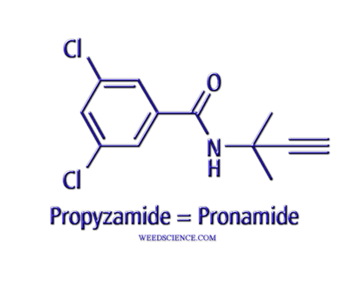
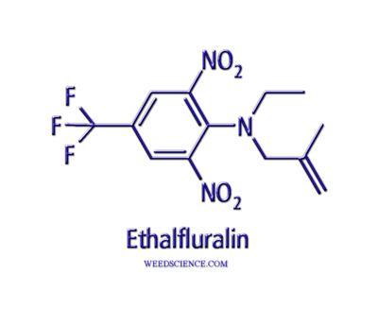
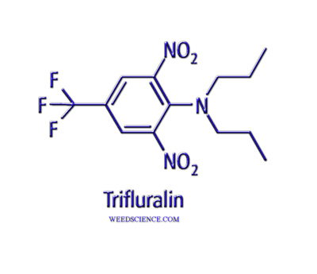
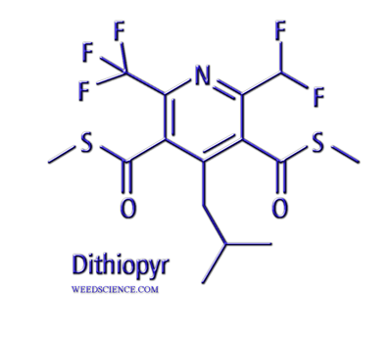
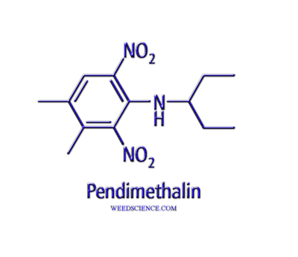
Mitotic Inhibitors

Slide 2
Mitotic Inhibitors
Active only on seedling shoots and roots
Pre-emergence and pre-plant incorporated
Essentially non-mobile in soil, but some movement is possible with certain herbicides
Very low water solubility restricts apoplastic movement, coupled with immediate activity

Slide 3
Mode of Action
Absorption of herbicide into seedling roots and shoot tissue
Some movement via soil water uptake
Most likely most uptake by roots growing and direct contact
Most affected plants don’t emerge from soil
Symptoms a result of damage to growth areas, manifesting as the plant grows

Slide 4
Mitotic Inhibitors - Tubulin Binding
Benzamides
pronamide, tebutam
Dinitroanilines
Benefin, butralin, dinitramine, ethalfluralin, prodiamine, oryzalin, pendimethalin, trifluralin

Slide 5
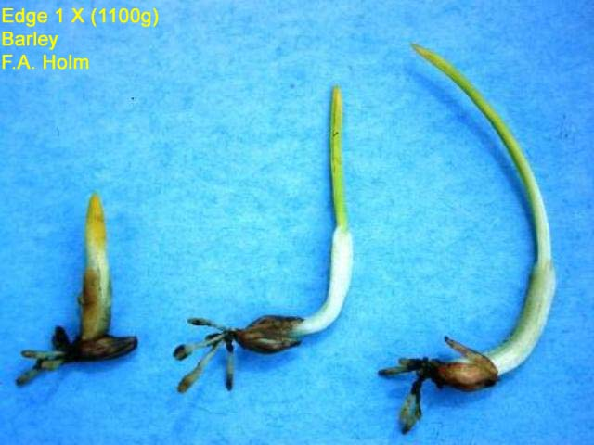
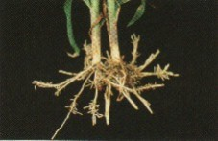

Slide 6
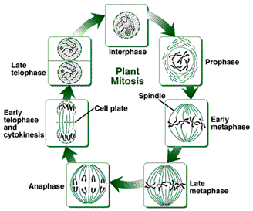

Slide 7
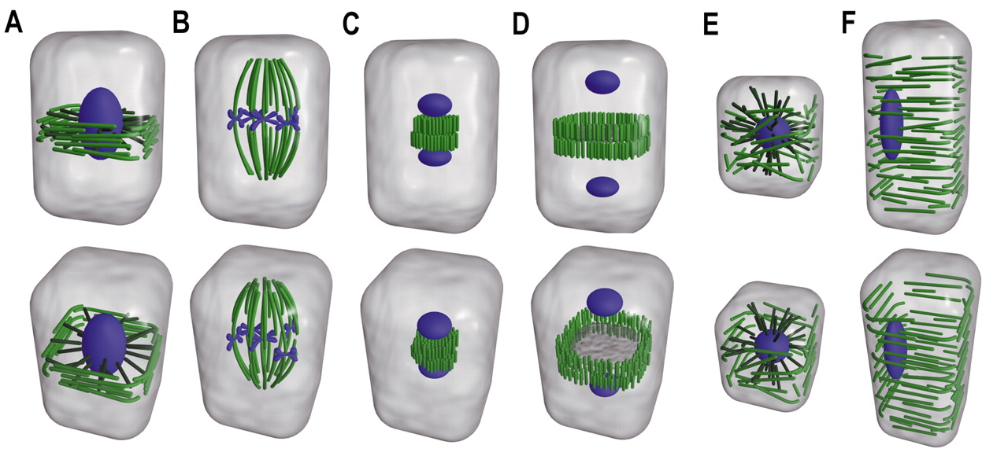
Microtubules in Plant Cells
Phragmoplast
Spindle
Spindle/phragmoplast
Spindle/phragmoplast
Phragmoplast/cortical
Cortical

Slide 8
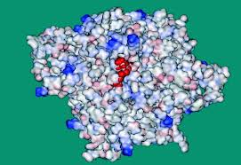

Slide 9
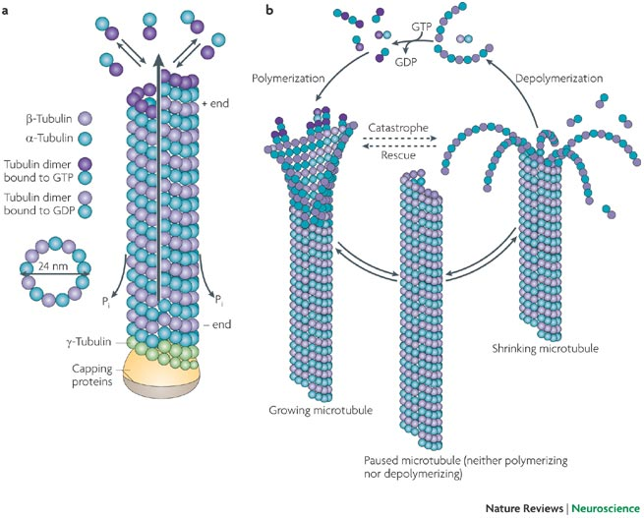

Slide 10
Mechanism of Action
Herbicides bind to the tubulin heterodimers in the cytoplasm, specifically α-tubulin
Prevent the formation of the microtubule through inhibition of the polymerization event
Spindle and phragmoplast microtubules are the most sensitive, because these are the most dynamic

Slide 11
Resistance
Single amino-acid change at positions 136 and 239 in the α-dimer
136 – leucine to phenylalanine
239 - threonine to isoleucine

Slide 12
Mitotic Inhibitors - Other Mechanisms
DCPA
doesn’t bind tubulin, appears to affect phragmoplast more than spindle microtubules
Bensulide
unclear, affects cell division but not mitosis
Carbamates - asulam, chorpropham, and propham
affect cell division through abnormal microtubule arrangement
lagging chromosomes, chromosome fragmentation, multinucleate cells
Pyridines - dithiopyr and thiazopyr
loss of microtubules but does not bind to tubulin
binds to MAP (microtubule associated protein)
necessary to stabilize growing microtubules

Slide 13
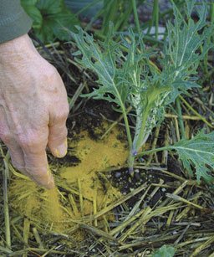
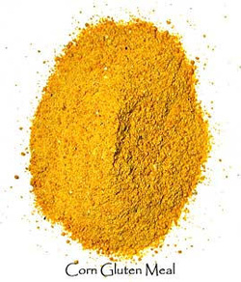
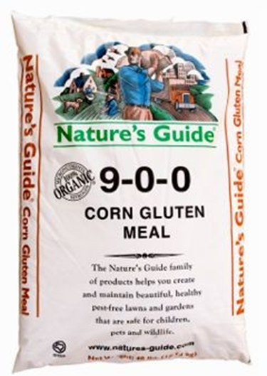
Corn Gluten Meal
Hydrolyzed fraction of corn protein
Corn gluten hydrolysate
20 lbs product per 1000 ft²

Slide 14
Corn Gluten Meal
Prevents root formation of germinating seedlings – similar activity (but not shoots)
Five dipeptides (Gln-Gln), (Gly-Ala), (Ala-Glu), (Ala-Asp) and (Ala-Ala) are active
Ala-Ala is the most active, inhibiting cell division through a metabolic process, but not the process of cell division

