Slide 1
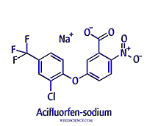
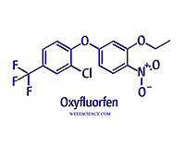
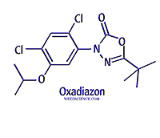
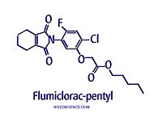
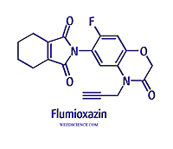
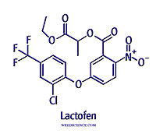
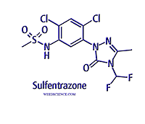
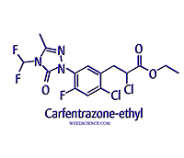
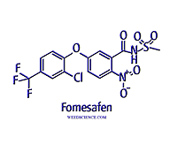
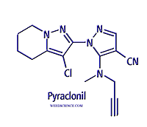
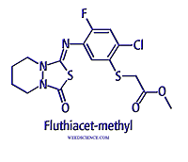
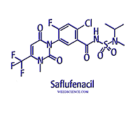
Protox (PPO) Inhibitors

Slide 2
Protox (PPO) Inhibitors
Diphenylethers (8)
Aciflurofen, bifenox, fomesafen, lactofen, oxyflurfen
N-phenylphthalimides
Flumiclorac, flumioxazin, cinidon
Oxadiazoles – oxadiargyl, oxadiazon
Oxazolidinediones – pentoxazone
Phenylpyrazoles – fluazolate, pyraflufen
Pyrimidindiones – saflufenacil,
Thiadiazoles – fluthiacet, thidiazimin
Triazolinones – azafenidin, carfentrazone, sulfentrazone

Slide 3
History
Oxadiazon discovered in 1969
Diphenyl-ethers in mid 1970’s and 1980’s
Phenylpyrazoles, pyrimidindiones, thiadiazoles, triazolinones registered in late 1980’s up to current (mid 2000’s)

Slide 4
Mode of Action
Primarily soil applied with root uptake via the xylem, translocated to leaves and shoots
Several can be applied to foliage but act as contact herbicides – no translocation
Saflufenacil appears to have limited phloem mobility – but does not contribute to activity
Moderate water solubility for most, but some pose groundwater concerns

Slide 5
Mode of Action
Predominately broadleaf weed control
Fomesafen has yellow nutsedge activity
Some grass activity – small seedlings only
Flumioxazin and carfentrazone have activity on submersed aquatic weeds
Foliar contact-type burning, but some can cause severe stunting

Slide 6
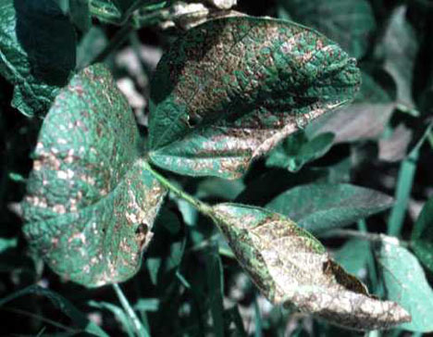
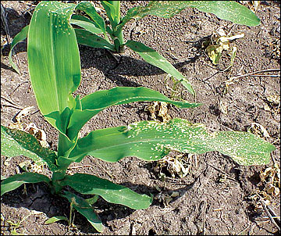
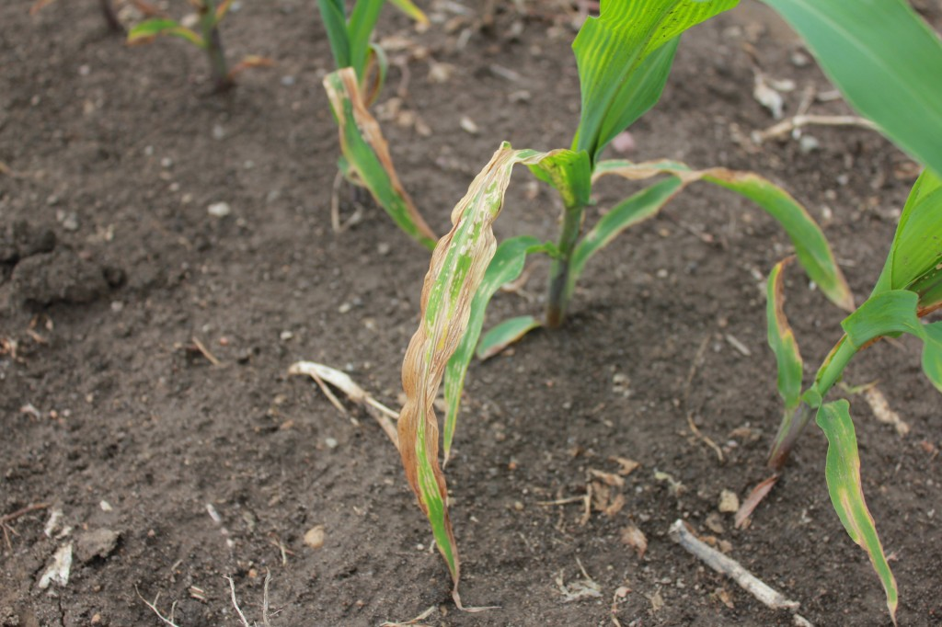
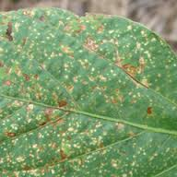
Symptomology

Slide 7
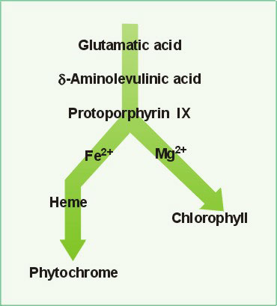
Mechanism of Action
Blocks activity of protoporphyrin IX oxidase
Competitive with substrate protoporphyrinogen IX
Causes an increase in the level of protoporphyrin, which is a light absorbing intermediate molecule
Unable to dissipate energy
Forms singlet oxygen
Lipid peroxidation

Slide 9
Selectivity
Primarily metabolism
Cleavage of the ether bond is the main mechanism
Many herbicides mechanism not known or not reported
Placement can be a method in perennial systems

Slide 10
Resistance
Tall waterhemp (Amaranthus tuberculatus)
Deletion of glycine at position 210 in the enzyme
Changes conformation of the enzyme
Causes the pocket to be wider, decrease affinity of herbicide

Slide 11
Chemistry
Essentially the same molecule
Acifluorfen 10x more water soluble, 10x less persistent
Lactofen more active on plants
Flumioxazin half life in water
pH 5.0 (3.4 to 5.1 days)
pH 7.0 (21 to 24 hours)
pH 9.0 (14 to 17 minutes)

