Slide 1
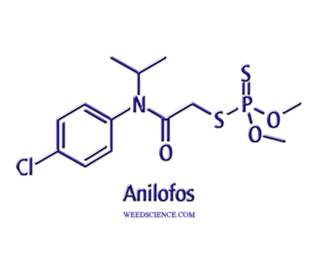
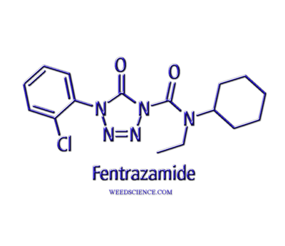
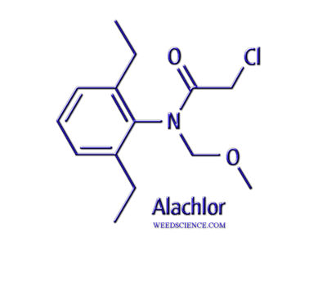
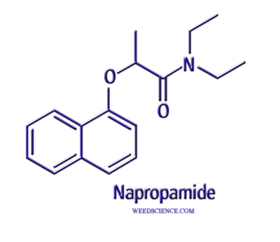
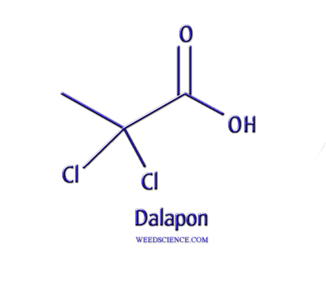
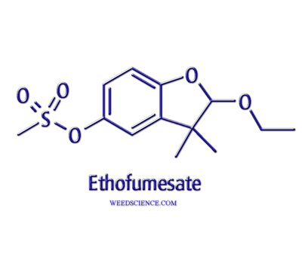
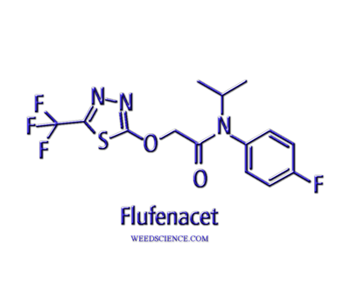
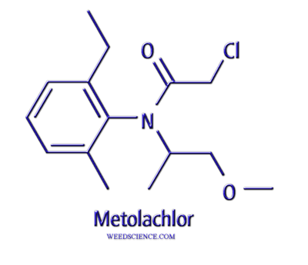
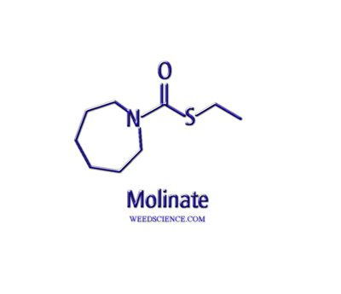
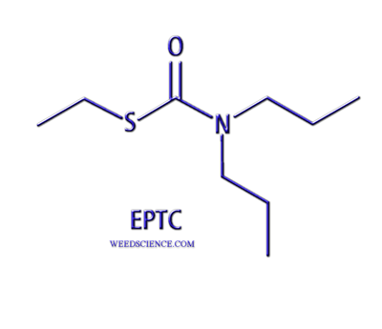
Very Long Chain Fatty Acid Synthesis Inhibition (VLCFA)

Slide 2
VLCFA Inhibitors
Acetamides – napropamide, etc. (3)
Chloroacetamides (12)
Alachlor, metolachlor, acetochlor, propachlor, dimethanamid, butachlor…………..
Oxyacetamides – flufenacet, mefenacet (2)
Benzofuranes – ethofumesate (2)
Tetrazolinones – fentrazamide (1)
Thiocarbamates – (13)
EPTC, pebulate, butylate, vernolate, triallate, molinate, cycloate
Additional herbicides (6)

Slide 3
VLCFA Inhibitors
Active only on seedling shoots and roots
Pre-emergence and pre-plant incorporated
Essentially non-mobile in soil, but some movement is possible with certain chloro-acetamides
Very low water solubility restricts apoplastic movement, coupled with immediate activity

Slide 4
Mode of Action
Absorption of herbicide into seedling roots and shoot tissue
Some movement via soil water uptake
Most likely most uptake by roots growing and direct contact
Most affected plants don’t emerge from soil
Symptoms a result of damage to growth areas, manifesting as the plant grows

Slide 5
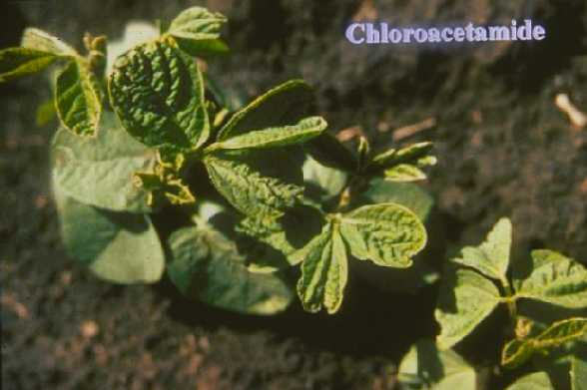
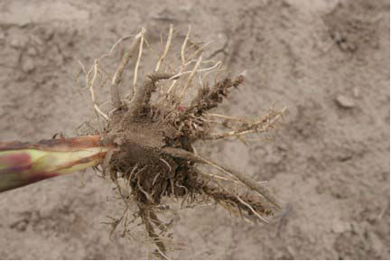
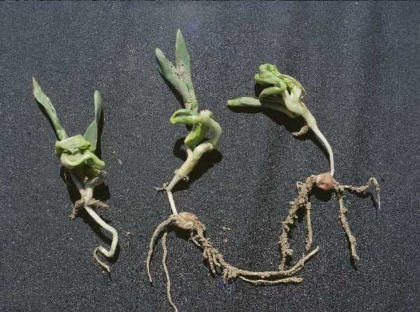
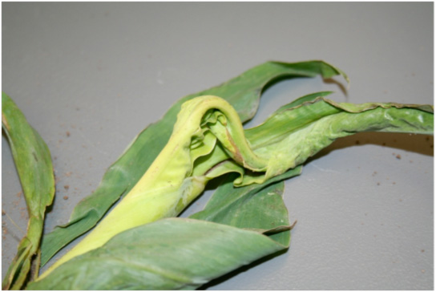

Slide 6
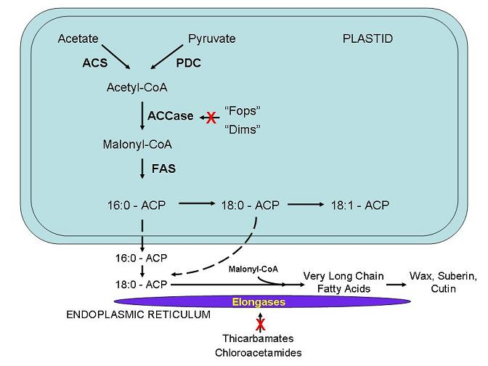

Slide 7
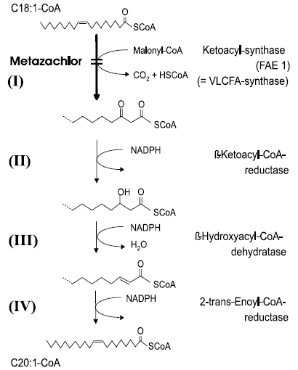
Mechanism of Action
Elongases are enzymes that catalyze the formation of long chain fatty acids
C18 fatty acids are transported from the chloroplast to the endoplasmic reticulum
Elongases add a 2 carbon unit to lengthen the fatty acid chain
4 clustered enzymes act in series
Herbicides block the first enzyme, VLCFA synthase
Competes with the substrate, malonyl-CoA for binding and eventually becomes irreversible

Slide 8
Mode/Mechanism of Action
Elongation step is blocked, pointing to elongases as the critical step
Most evidence points to VLCFA synthase as the target enzyme for all in this classification
Thiocarbamates must be metabolized to an active form by sulfoxidase enzymes

Slide 9
Selectivity
Primarily placement of the herbicide within the top layer of soil
Contacts small seeded weeds such as pigweeds, Florida pusley, and most grasses
Crop plants are planted below the treated zone, thus limiting uptake of the herbicide
Chloroacetamides – some crops have ability to metabolize herbicides via glutathione conjugation (corn)

Slide 10
Safeners and Extenders for Thiocarbamates
Dichlormid
enhances sulfate metabolism which increases glutathione activity
may act as a competitive inhibitor for uptake for EPTC
Dietholate
microbial inhibitor used with EPTC and butylate
called ‘extenders’

Slide 11
Safeners for Chloroacetamides
Benoxacor
applied in conjunction with metolachlor (20:1 ratio)
enhances the rate of S-metolachlor detoxification in corn and potatoes
activity includes removal of chlorine, subsequent glutathione conjugation and hydrolysis to an alcohol metabolite that is conjugated by glucose
Dichlormid
specifically used with acetochlor (chloroacetamide)
induces the synthesis of glutathione S-transferease isozymes which metabolize the herbicide

Slide 12
Safeners for Chloroacetamides
Fenclorim
used in conjunction with pretilachlor (chloroacetamide) to enhance GST activity in rice
applied as a seed treatment
pretilachlor and fenclorim not labeled for use in US
Fluxofenim - Concep III
used as a safener for chloroacetamide herbicides in sorghum (primarily S-metolachlor) but will work for most chloroacetamides
used as a seed treatment for sorghum safening - 0.4 g-ai/kg of seed
absorbed through seed coat of germinating sorghum seeds
elevates glutathione S-transferase activity which increases herbicide metabolism
Fluorazole – Screen - no longer in use
similar activity and use as Concep III

Slide 13
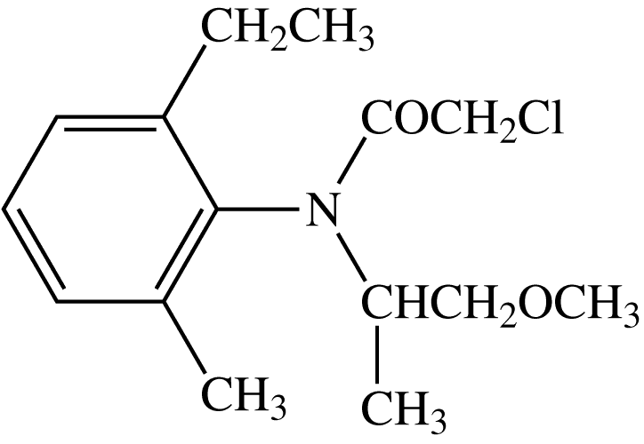
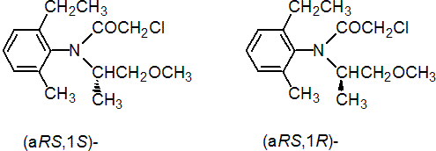
S-Metolachlor
Enantiomers
Only S form active
Original had both
New formulation only S

Slide 14
Resistance Mechanisms
Very slow to develop…… > 30 years (triallate)
Inability to metabolize herbicide to active form
Called “loss of function” mutants
Thiocarbamates
Chloroacetamides
Enhanced metabolism in barnyardgrass and rigid ryegrass

